Slide 1
REP TRAINING
Rep Portal, Literature, Warranty

Slide 2
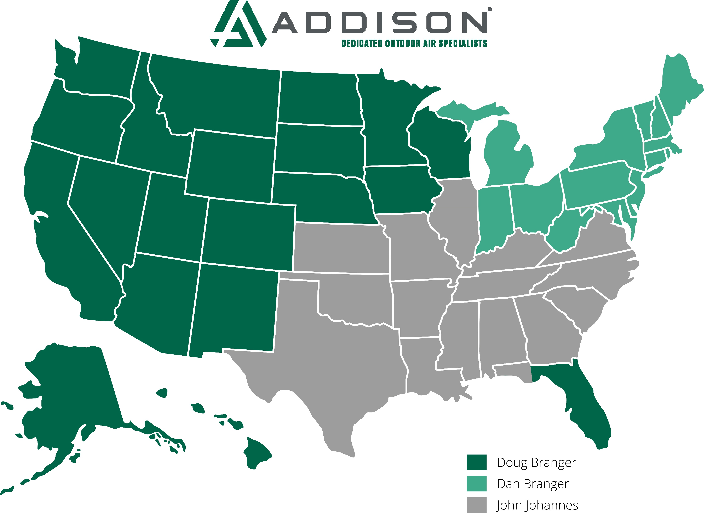

Slide 3
Why are we here?

Slide 4
To MEET THE CUSTOMERS NEEDS

Slide 5
EVERYTHING YOU LEARN THE NEXT Three DAYS WILL BE TO…
MEET THE CUSTOMERS NEEDS

Slide 6
You want customers calling you asking if YOU can solve their issue. When you get those calls, you are where you need to be.

Slide 7
There are two types of sales people. Do you know the two types?

Slide 8
QUOTERS

Slide 9
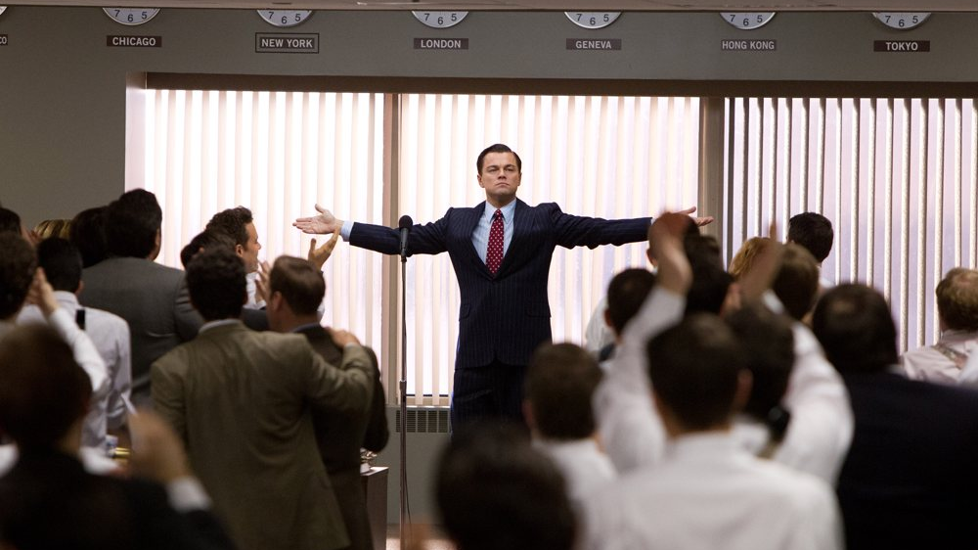
Closers!

Slide 10
How many people in here have attended a sales training course? 90% of sales people have never attended a course

Slide 11
If you call on engineers, what is your goal??

Slide 12
BOD BASIS OF DESIGN

Slide 13
Every day ask yourself, how do I meet my customers needs?

Slide 14
THANK YOU

