Slide 1
Rep Training
AK Series Product Training

Slide 2
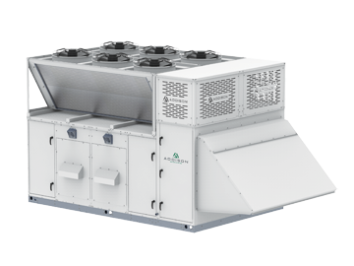
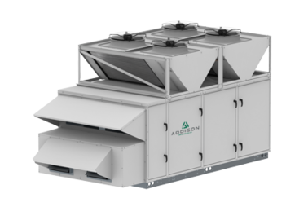
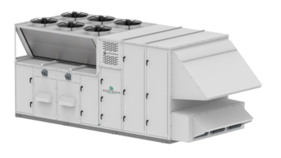
PRAK Series
PRAK
PRRA
PREK
575V Not Available

Slide 3
AK Series
Compact Footprint series
3 – 90 Tons
400 to 19,000 CFM
EC Fan motor
2” Foam Injected Cabinet
Bitzer Scrolls – Optional Lead VFD Option
Condensing fans: axial sickle shaped w/ VFD
Gas furnace max 1200 MBH
Electric heat max 150 kW
-20 °F winter design
PRAK – 100% OA, air cooled
PREK – 100% OA, air cooled with enthalpy wheel
PRRK – recirc / mixed air, air cooled (opt. enthalpy wheel)

Slide 4
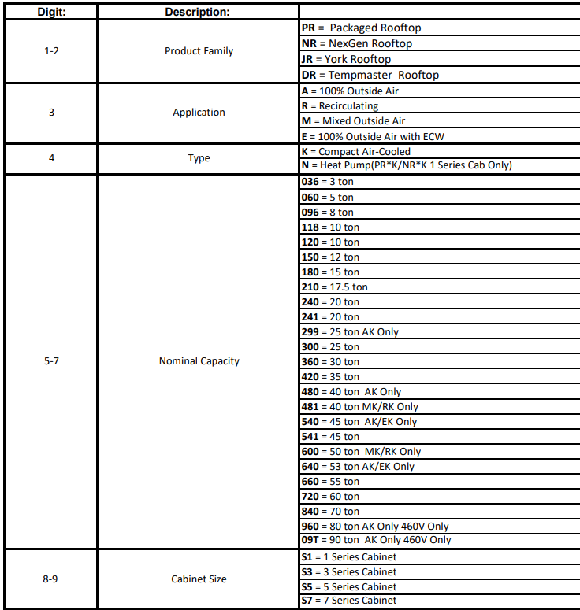
AK Series

Slide 5
AK Series
Air Cooled
Liquid Sub Cool and HGRC standard for 100% OA
PRAK & PREK
PRRK offers Modulating HGRC
Smaller footprint over PR**
Less weight over PR**
MAY be less cost than PR*A

Slide 6
PRAK Series

Slide 7
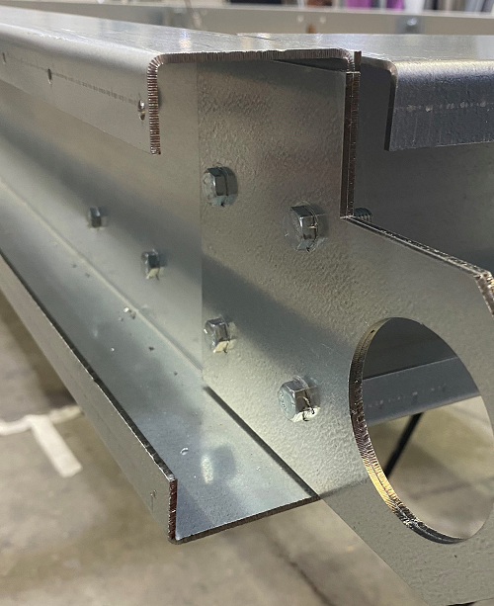
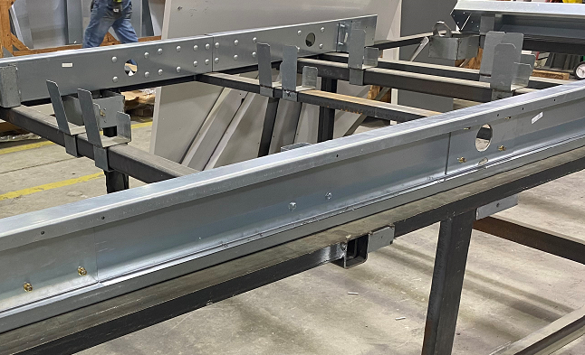
AK Series, Base
“C” Channel, 12 ga. G-90 steel
Bolted construction
Cabinet: S3 and S5
6” base rail

Slide 8
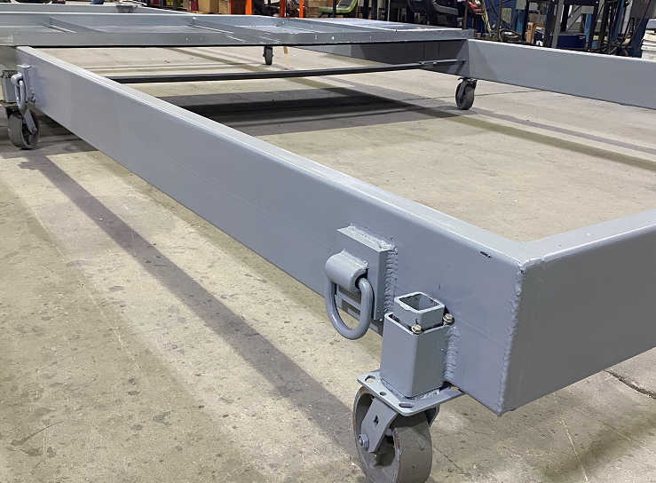
AK Series, Base
Tubular structural steel
Welded construction
Cabinet: S7 ( without ECW Wheel)
4” base rail
Cabinet: S7 ( with ECW Wheel)
6” base rail

Slide 9
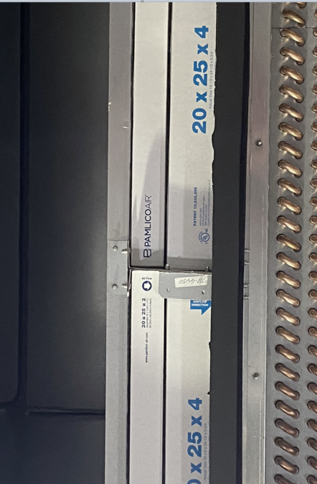
AK Series, Filter
Galvanized steel track
2” + 4”
All prefilter location
Magnehelic gauge, local read only
Clogged filter switch, BMS alarm

Slide 10
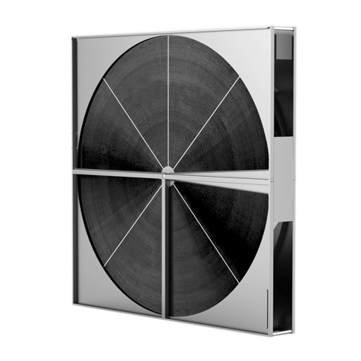
Energy Recovery Wheels, PREK & PRRK
Poylmer wheel, segmented, with silica gel desiccant
ADD Option: Aluminum substrate, single piece, with 3A (angstrom) molecular sieve desiccant
Purge feature
Bearings L-10; 30 years maintenance free
Slide out cassette for ease of cleaning and maintenance

Slide 11
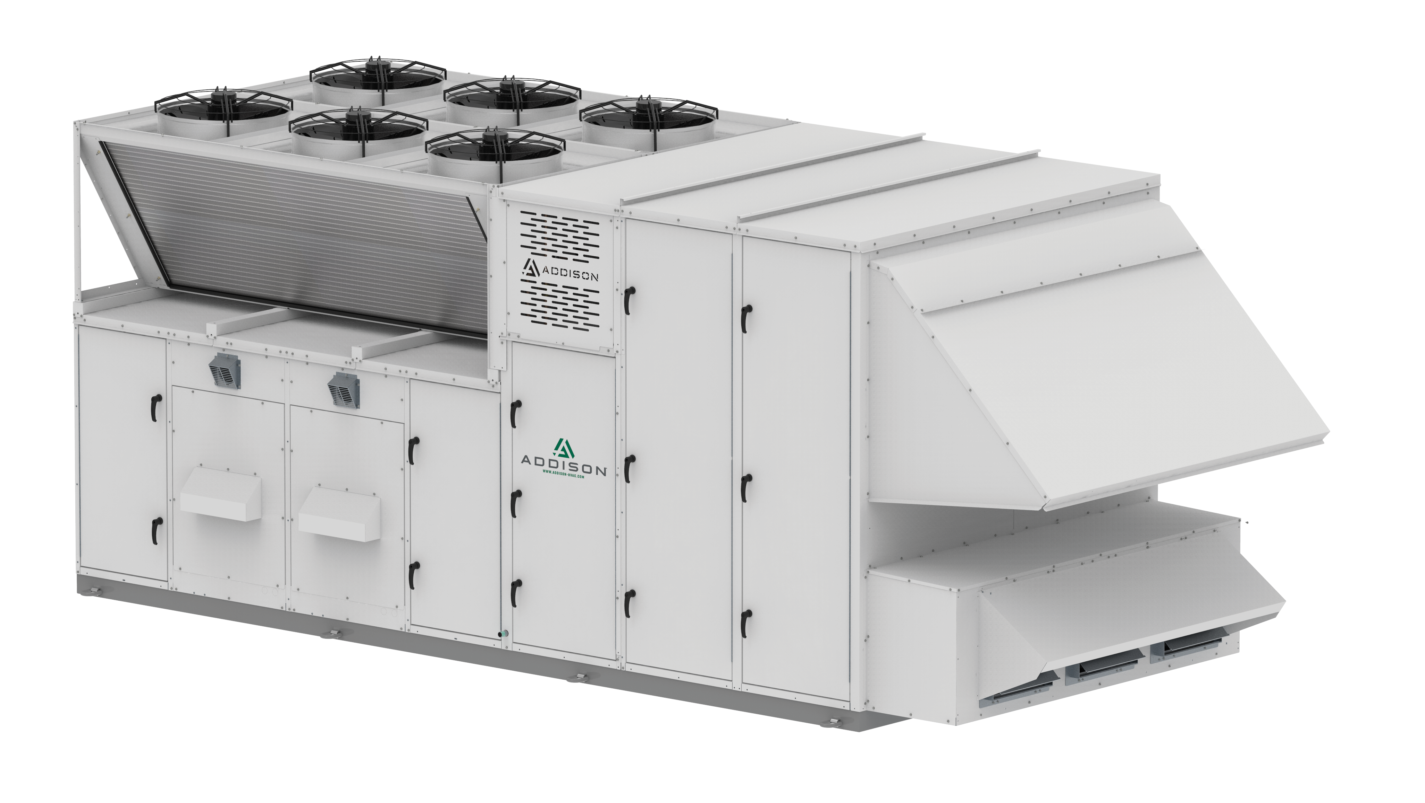
EK and RK Series Unit
ADD Option: Energy Wheel with Exhaust Fan:
Available from 3 - 70 Ton cabinet size
Exhaust fans located in ‘bump out’
LH and RH access w/ RH for ‘pull’ to remove enthalpy wheel

Slide 12
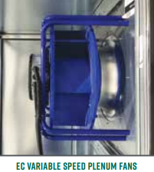
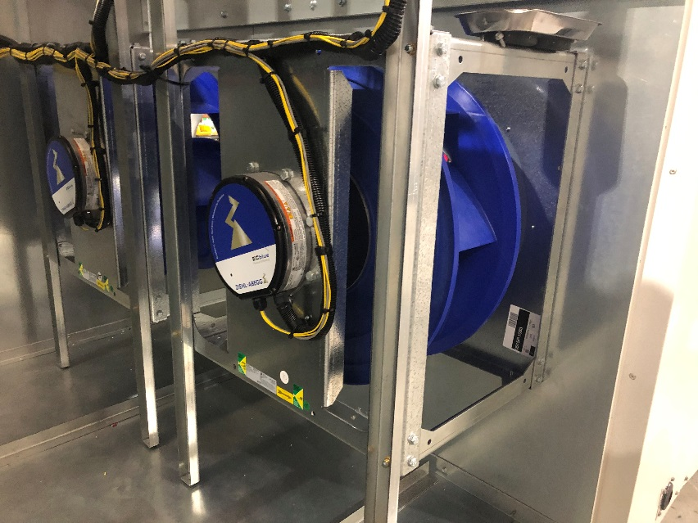
AK Series, EC Fan Motor
575V not available, today
Ziehl Abegg, EBM Papst, Rosenberg
Check your ACE selection for fan quantity and specification opportunity

Slide 13
PRAK Series

Slide 14
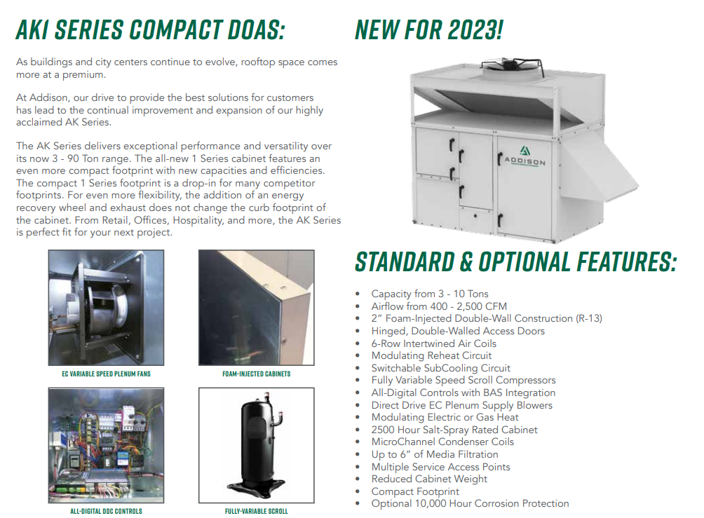
PR_K, 3 - 10 Tons, S1
Code string PR_K118S1
Mitsubishi inverter compressor:
PRAK118S1 dx LAT high at 200cfm/ton
PRRK, PREK ‘manageable’ with lower EAT with the help mixed air or wheel
Is a lower first cost than PR_K120S3

Slide 15
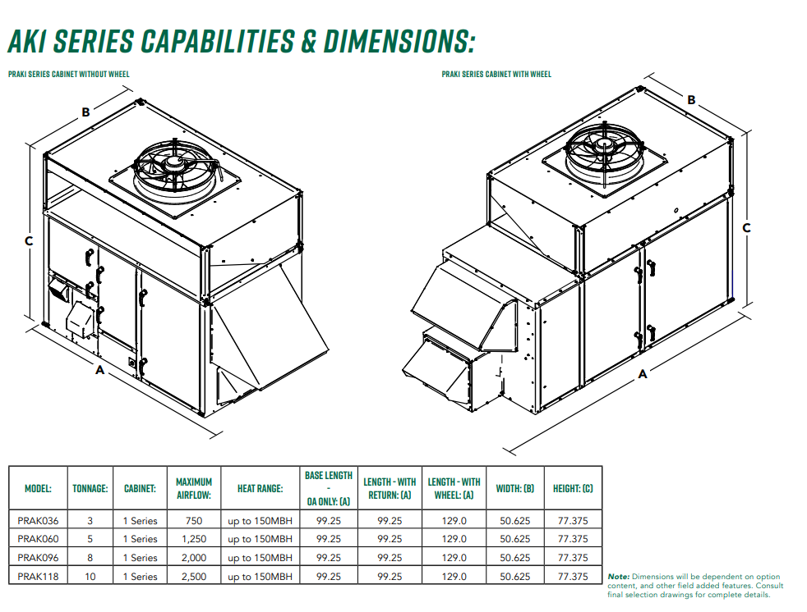
Code string PR_K118S1
150MBH Gas Heat:
Maximum output from factory
Cold weather regions: ASHRAE zone 5,6,&7 and Canada
Supplemental duct furnace ?
Is a lower first cost than PR_K120S3

Slide 16
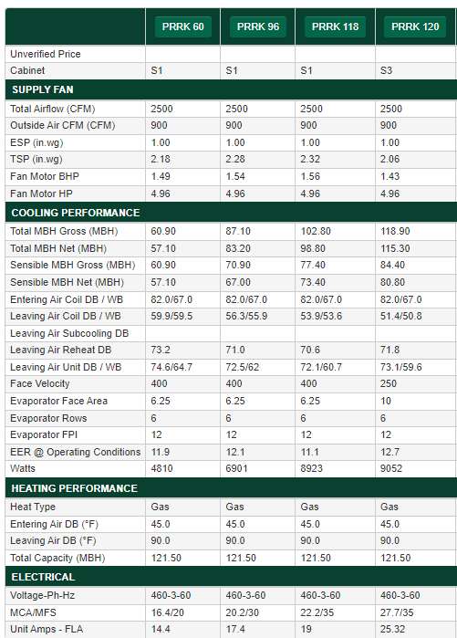
PRRK118S1, Base: $35000 ~ $3.5 k/ton
PRRK120S3, Base: $55,000K ~ $5.5 k/ton

Slide 17
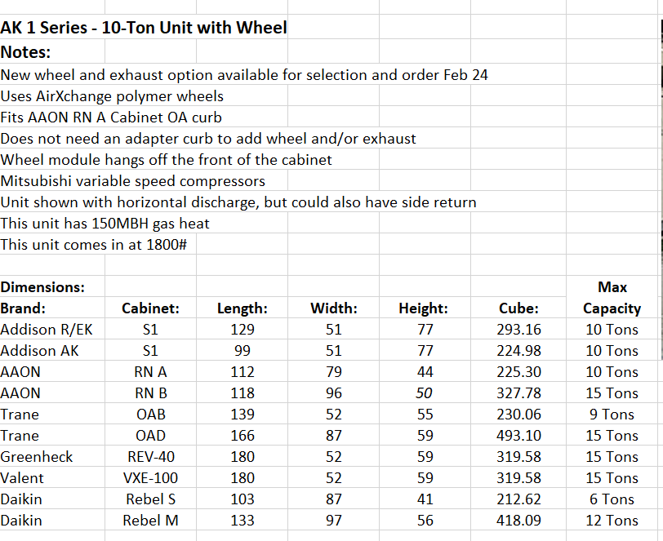
AK-1 vs. Competition

Slide 18
AK-1 vs. Competition

Slide 19
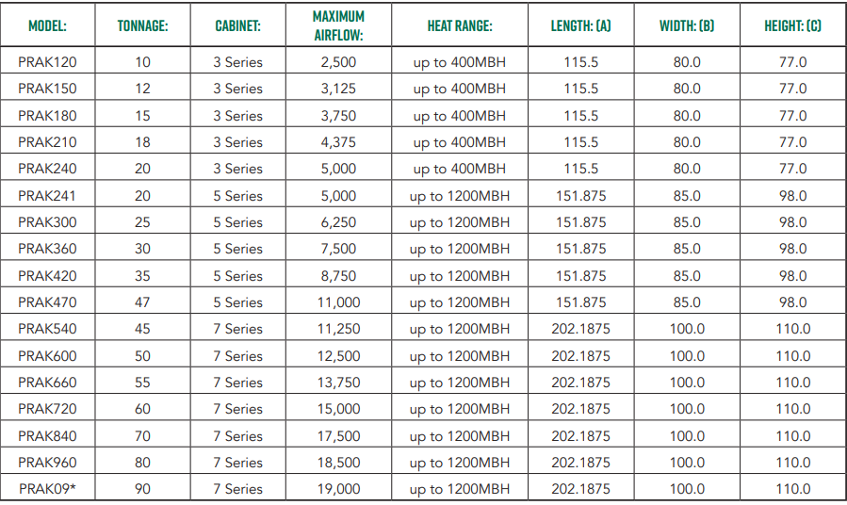
PRAK Series Capabilities and Dimensions

Slide 20
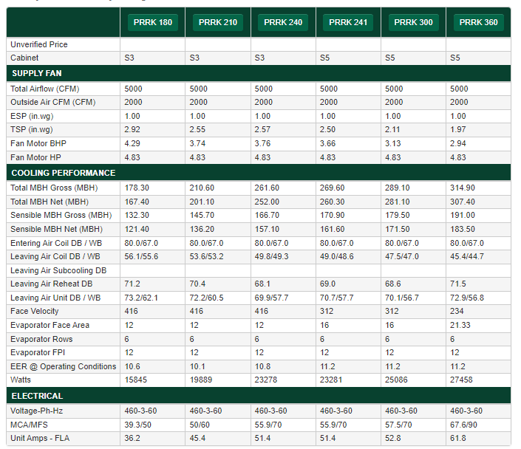
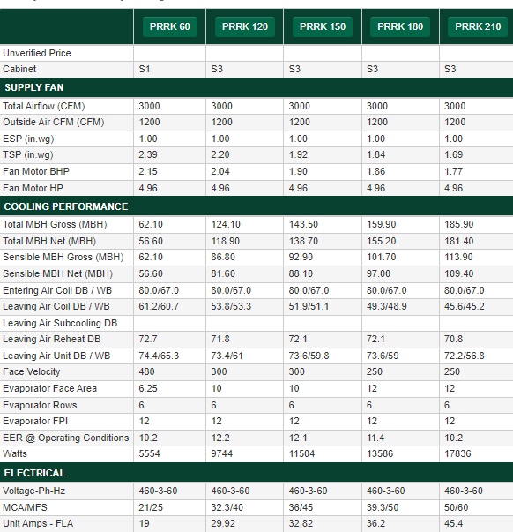
PRRA Recirculation with Exhaust fan or w/o exh fan

Slide 21
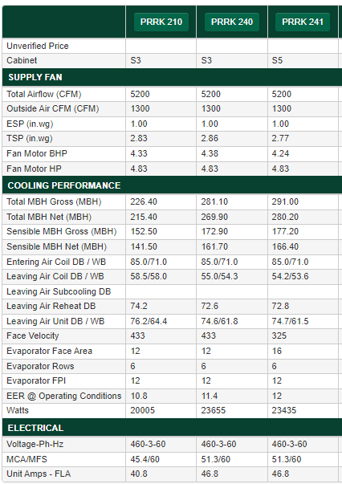
PRRA Recirculation with Exhaust Fan
Real Basic $52K ~$2.9k/ton
Real Basic $58K ~$2.9k/ton

Slide 22
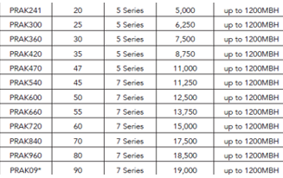
PRRA Mixed Outside air ( 3-70 tons)
2 Cabinet Sizes S5 and S7
Replacement for Legacy PCA/DCA Footprints
Replacement for Other MFGs Footprints
Adapter curbs can be used for most applications
20 – 90 Tons
5000 to 19,00 CFM
Prak 3-90tons
PRRK 3-70 ton
PREK 3 -70 ton

Slide 23
FAQ
Special Tracker items not reviewed in preso
oA intake and ea discharge on same end – cross contam
Show plan dwg where elect serviced is introduced but where disc might be though

Slide 24
PROA vs PRAK

Slide 25
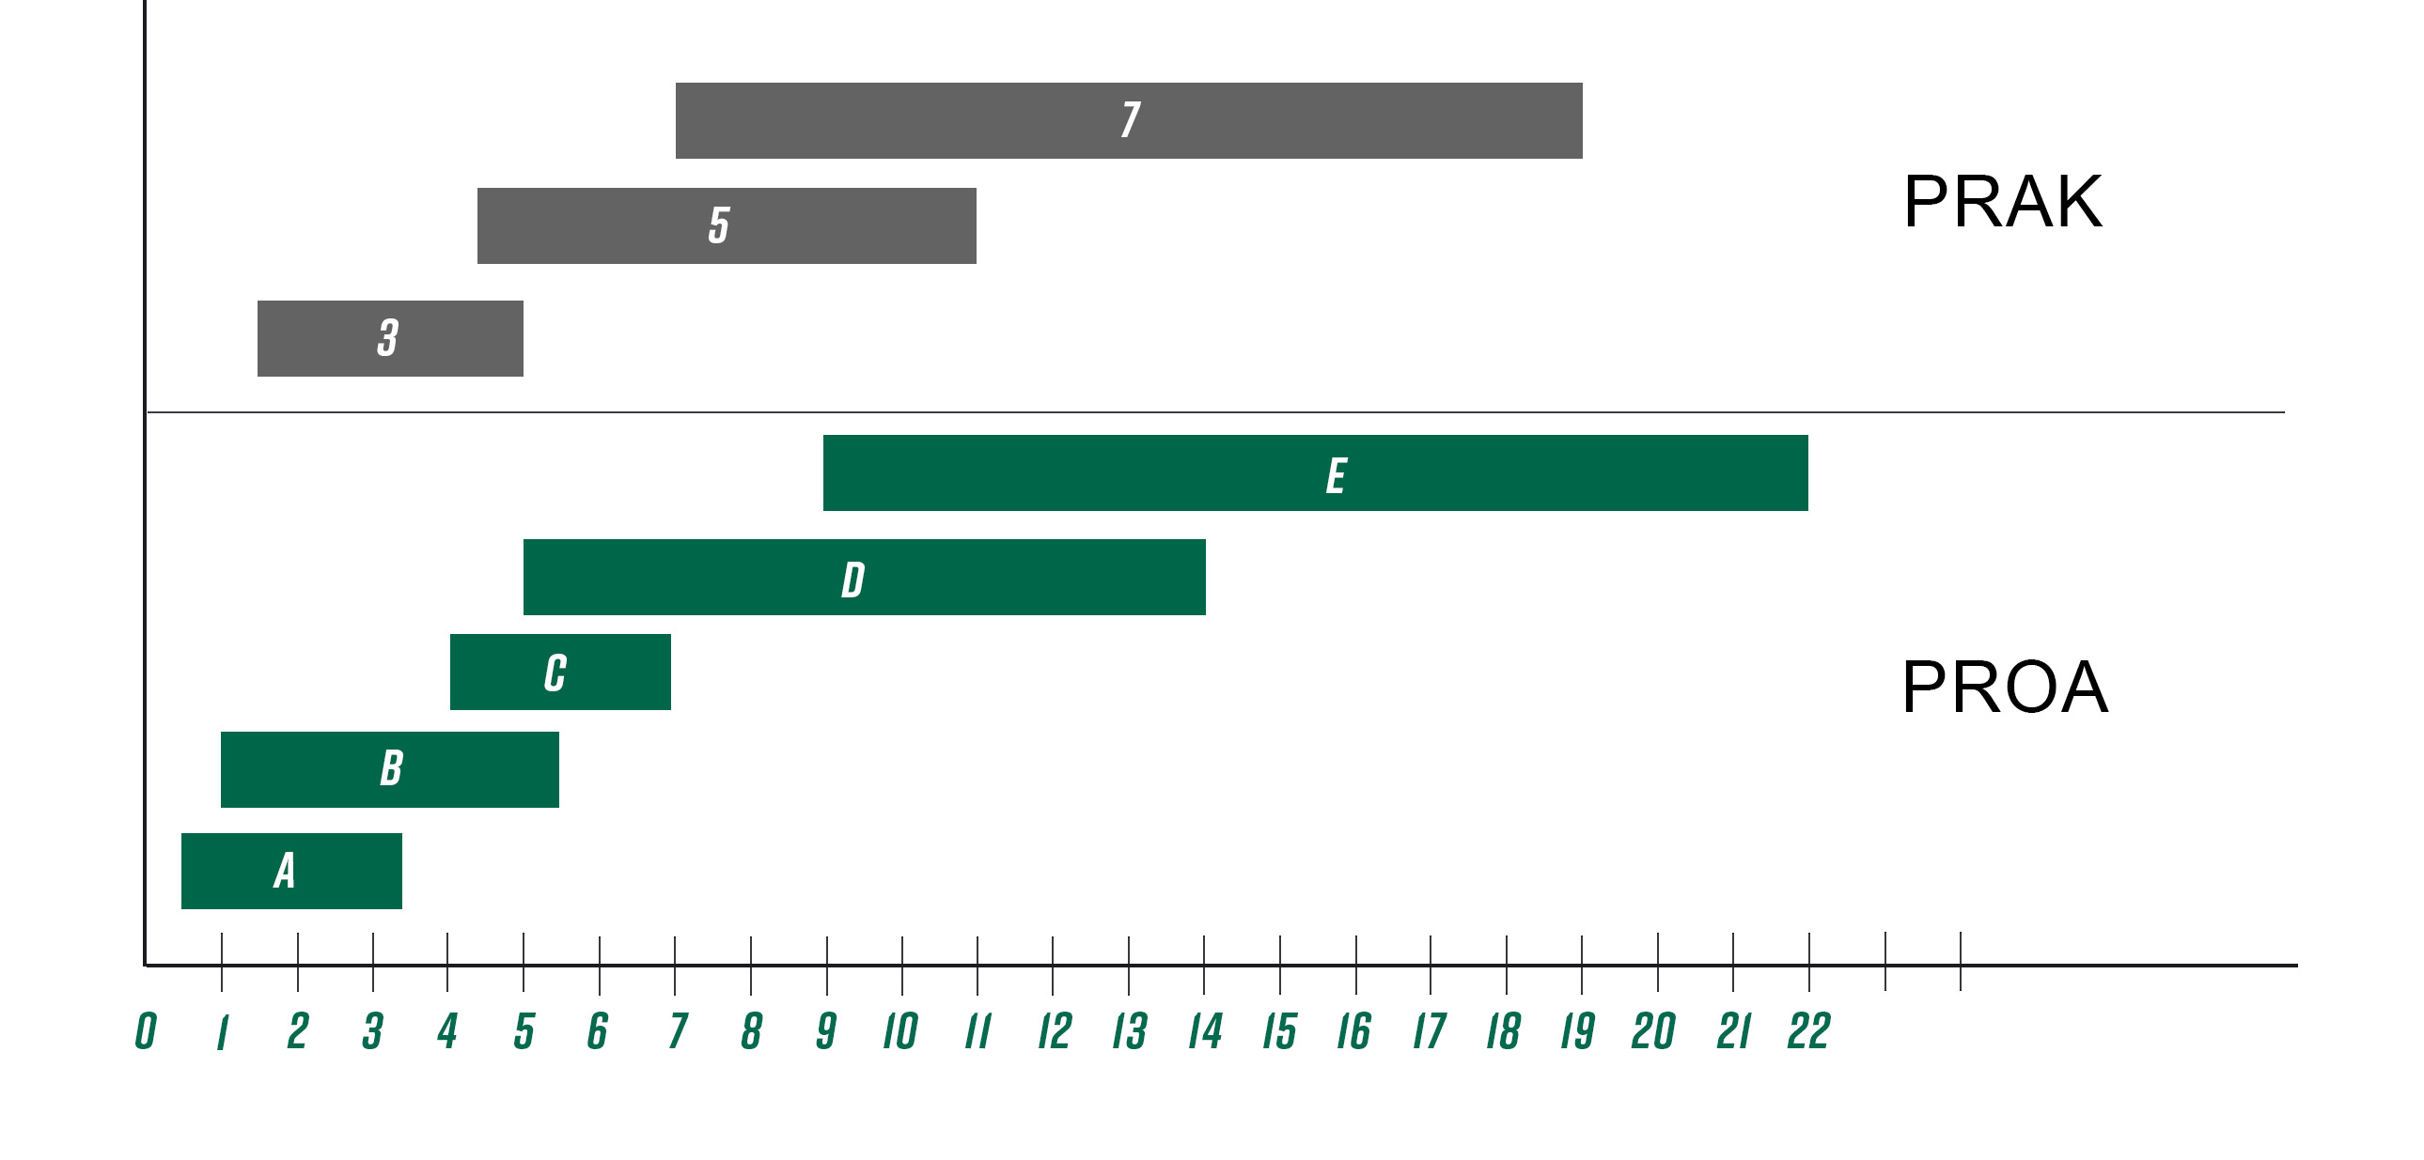
PROA vs PRAK Airflow Cabinets
Notes:
Why are some of my selections favoring the PROA vs the PRAK?
The PRAK was designed with an emphasis on a more compact footprint.
The PROA will have more options and applied specials available.
In some cases, the PROA will be less expensive especially if you are in the upper box size and the PRAK is in the lower box size.
In certain applications, the PROA model might be the better choice.
The key is you can use both the PROA and PRAK Series to bid all jobs.

Slide 26
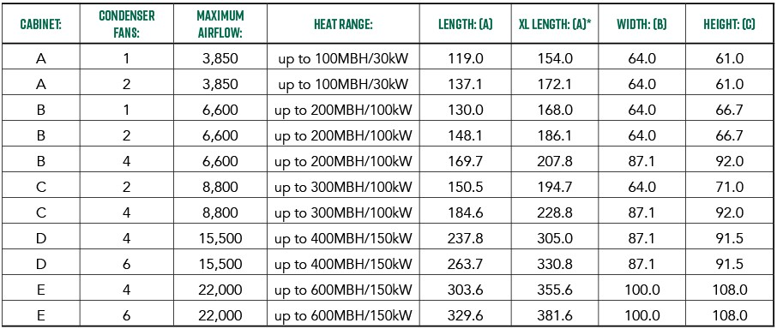
PR SERIES Capabilities & Dimensions
In the PR code string, an “XL” means cabinet extension for heat : electric KW or gas – dual /quad. This equates to an increase in cabinet cost and provides a signal to price check with an AK unit

Slide 27
PROA vs PRAK SIZE
PROA |  |  |  | PRAK | PRAK
Cabinet | Length | Width | Height | Cabinet | Length | Width | Height
A | 137 | 61 | 55 | 1 | 99 | 51 | 77
B | 170 | 87 | 92 | 3 | 115 | 80 | 77
C | 185 | 87 | 92 | 5 | 152 | 85 | 98
D | 264 | 87 | 92 | 7 | 202 | 100 | 110
E | 330 | 100 | 108 | 9
AK smaller footprint over PR – freight costs
AK Less weight over PR – design and structural

Slide 28
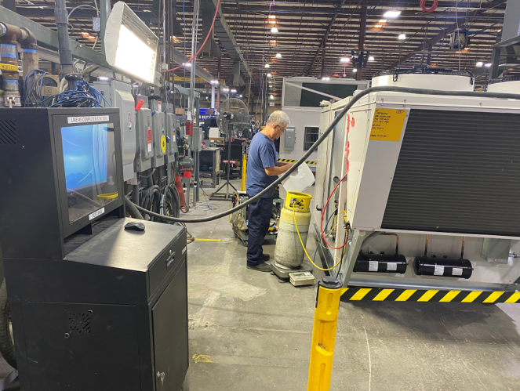
Each units is tested

Slide 29
THANK YOU

