Slide 1
REP TRAINING
Controls

Slide 2
What We Will Cover

Slide 3
What We Will Cover
Scope
Control Alarms and Modes
Control Methodologies
Control hardware from OEMCtrl (LS-1628u / Equipment Touch v3 / ZSensor)
Sequences of Operations (SOO)

Slide 4
Scope Purpose of Controls
Protect Equipment
Communicate Status (BAS/HMI)
Operational Efficiency
Notes:
Our controls act in a three fold manner. First, is to protect the equipment from damage to itself or from damaging property. Next, is to make available pertinent data and alarms to the people operating the equipment, via touchscreen, PC or BAS frontend. Ultimately, with these fundamentals handled, the control logic enables intelligent use of kWh to deliver the most efficient conditioning of supply air.

Slide 5
Topic Indicators
Notes:
The rest of what we talk about falls under at least one of these three categories, sometimes more!

Slide 6
Available Alarms
Alarm Definitions
Life safety (ie. Smoke Detection, High CO₂)
Critical Lockout (High Pressure, etc)
Urgent “Trip” (1st and 2nd alarms of HPS, LPS, etc)
Normal message
Alarm Information Provided:
Timestamp, Alarm Name, Critical (Y/N), Lockout (Y/N)
Generally, “three strikes you’re out”
Notes:
The rest of what we talk about falls under one of these three categories

Slide 7
Available Alarms
Alarms
T.24 FDD
SF Hand/Stp
ExFan Hand/Stop
Comp Hand/Stop
LPS Hand/Stop
HPS Hand/Stop
DX Freeze
Heat Fail
High/Lo SAT
Water Freeze
Water Flow Switch
Smoke
Sensor Fail
Dirty Filter
Cond Ovrflw
High CO₂
Notes:
The rest of what we talk about falls under one of these three categories

Slide 8
Communications - BACnet
Our controller is BTL Certified which guarantees interoperability with all major BAS frontends and devices.
BACnet IP
BACnet MS/TP
Notes:
The rest of what we talk about falls under at least one of these three categories, sometimes more!

Slide 9
Communications - BACnet
BACnet Point Properties
AO - Analog Output
BO - Binary Output
AI - Analog Inputs
BI - Binary Inputs
AV – Analog Value
BV – Binary Value
Present Value
Relinquish Default Value
Priority Array
Point Address (Object ID)
Notes:
The rest of what we talk about falls under at least one of these three categories, sometimes more!

Slide 10
Communications - BACnet
Notes:
The rest of what we talk about falls under at least one of these three categories, sometimes more!

Slide 11
Control Methodologies (PID Feedback)
Proportional
Integral
Derivative
Sensor
Setpoint
How FAR away from setpoint?
How LONG has it been away?
How FAST is it trending toward or away?
Notes:
Provide uniform sequences of operating HVAC DOAS units to ensure maximum performance.
Provide feedback loops for proper controls
Sensors need to be placed in the correct locations
PID Control loops need to utilize the input signals to meet the desired setpoints (Heating and Cooling Loops)
Not all control loops need to be PID loops
PID loops shall be capable of limiting the rate of change
Adjustable set points with dead bands
Trim and Respond set point logic for critical zone control

Slide 12
Control Methodologies (PID Feedback)
PROCESS PID
Enabled
Setpoint
Control Signal
Sensor
Notes:
The requirements for a PID to operate. Usually the “D” term is set to zero.

Slide 13
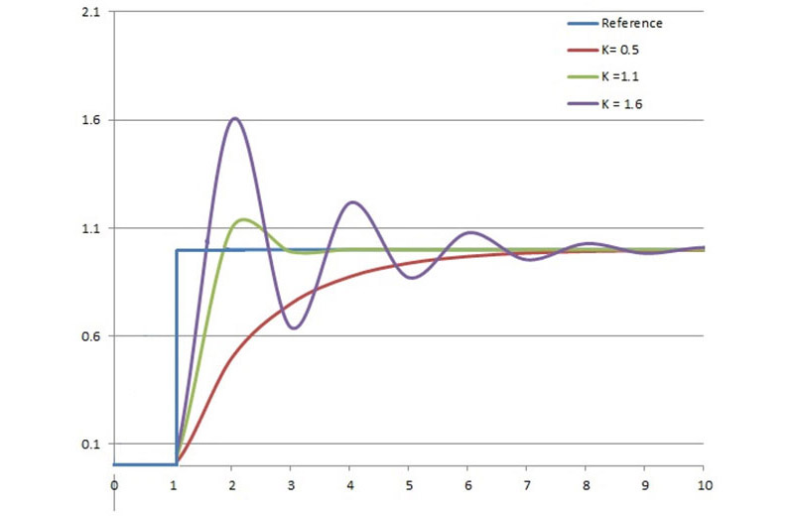
Control Methodologies (PID Feedback)
Notes:
Exaggerated example of PID control showing different tuned parameters for a step response (setpoint change, e.g.)

Slide 14
Control Methodologies, Hot Gas Reheat Valve example
Notes:
Example of Addison Standard program code controlling the HGRH valve enabled by dehumidification conditions and controlled by SAT Drybulb setpoint.

Slide 15
Control Methodologies, Hot Gas Reheat Valve example
Setpoint
Enabled
Sensor
Control Signal
Notes:
Example of Addison Standard program code controlling the HGRH valve enabled by dehumidification conditions and controlled by SAT Drybulb setpoint.

Slide 16
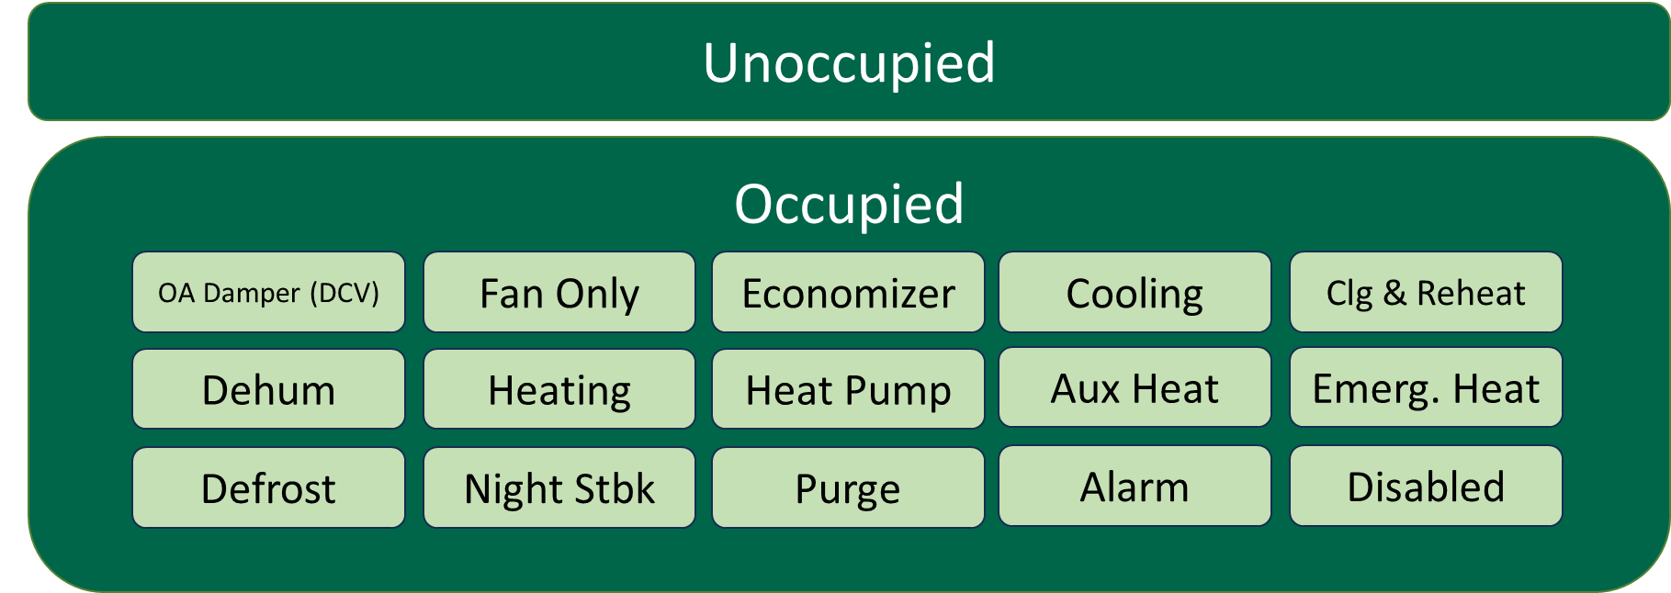
Example of Control Modes
Notes:
This is an abbreviated list of possible operating modes of our standard program. Based on the application and what has been enabled

Slide 17
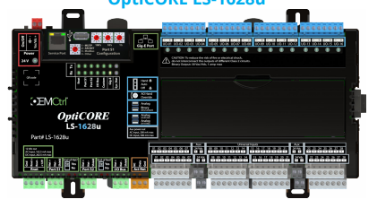
Enabling Technologies OPTICORE LS-1628u
Performance / Hardware
32-bit ARM core, Linux kernel
16GB Flash memory, 512MB RAM
Universal Inputs and Outputs
Communication Features:
3 Configurable Communication Ports
Gig-E: Gigabit Ethernet Port for BACnet/IP or Modbus/TCP, also allows addressing via DHCP
Port S1: Rotary configurable EIA-485 Port for BACnet MS/TP or Modbus
Port S2: Firmware configurable EIA-485 Port for BACnet MS/TP or Modbus
6 Dedicated Communication Ports
Service Port: 10/100 Ethernet port for technician access and touchscreen connection
Rnet: ALC proprietary Sensor Network. Can be used for touchscreen connection
I/O Bus Port: for I/O point expansion via screw terminal for remote mounting
I/O Bus Edge Connector: for I/O point expansion (includes power)
Act Net: Network of communicating valves and actuator
Comm Expansion Edge Connector Port: for comm expansion

Slide 18
OPTICORE LS-1628u

Slide 19
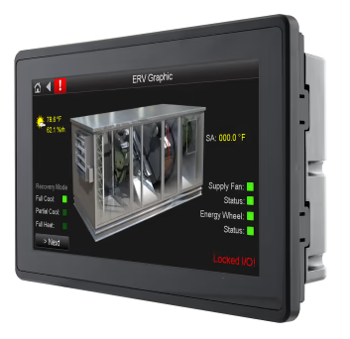
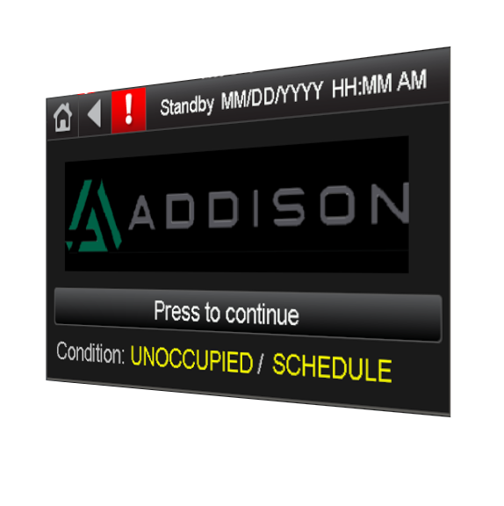
Enabling Technologies OptiCore Equipment Touch 3 (EQT3)
Fanless cooling system and ultra-low power consumption
Front IP65 water and dust proof
Access to most data points in the controller
Support for graphics and animations
Schedule Interface – view and edit BACnet schedules
Alarm Viewing – view the controls alarm history buffer
Customize for any application
NEW! Can access Service Port Page for communications setup

Slide 20
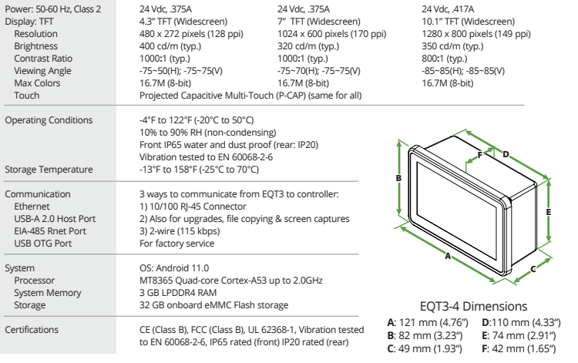
OPTICORE EQT3 Displays

Slide 21
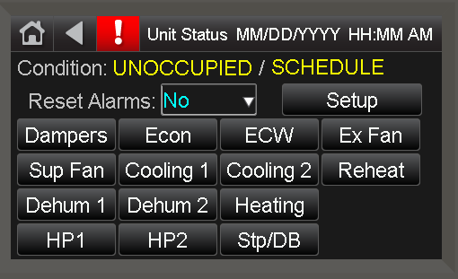
OPTICORE EQT3 Displays
Sample Screenshots

Slide 22
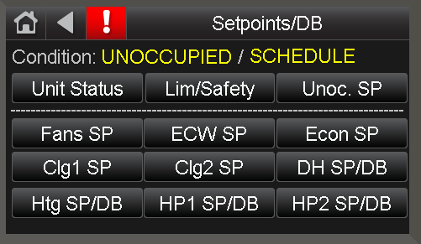
OPTICORE EQT3 Displays
Sample Screenshots

Slide 23
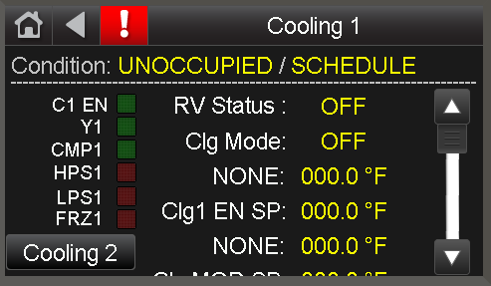
OPTICORE EQT3 Displays
Sample Screenshots

Slide 24
Displays EQ-10,EQ-7,EQ-2

Slide 25
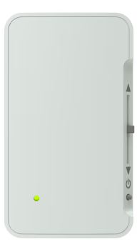
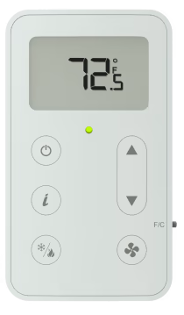
Enabling Technologies: ZS Sensors
Provide flexibility for multiple building applications
Low-profile, neutral color scheme
Efficient options for multiple sensors in one case
Units are daisy chainable, can control on average or min/max
Discreet service port for laptops to access the LS-1628u
Mounts on a standard 2 inch by 4-inch electrical box
Combinations can include zone temperature and/or relative humidity, CO2, VOC
Multiple models offer a choice of options, including a large easy-to-read display, local setpoint adjustment, local override, and fan control

Slide 26
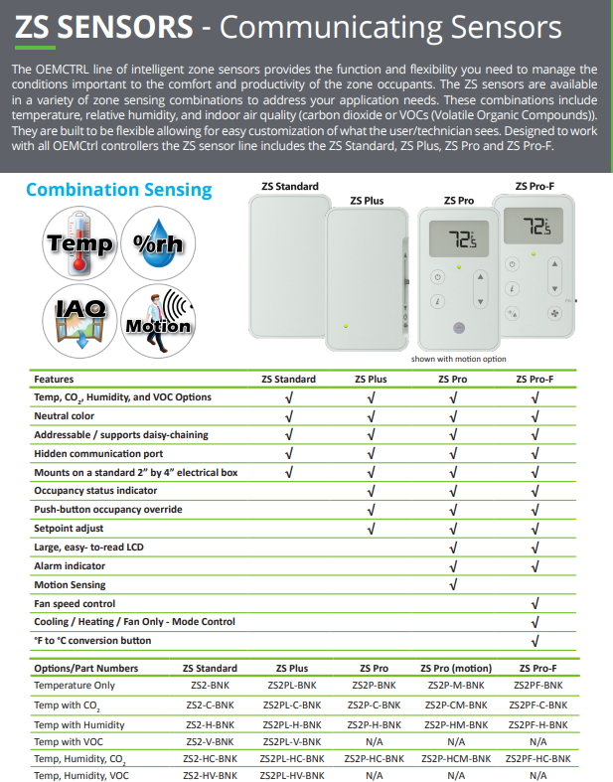
ZS Sensors

Slide 27
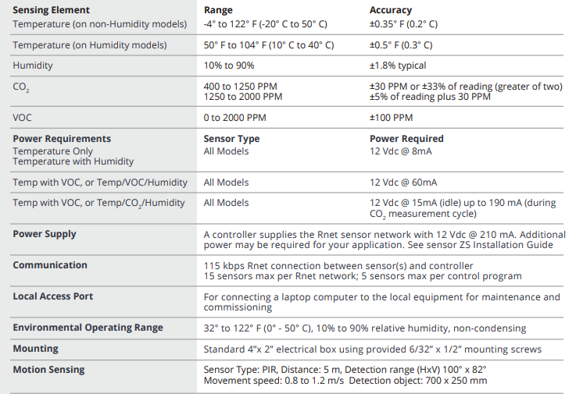
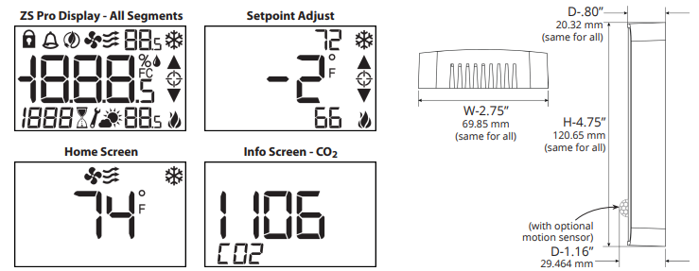
ZS Sensors

Slide 28
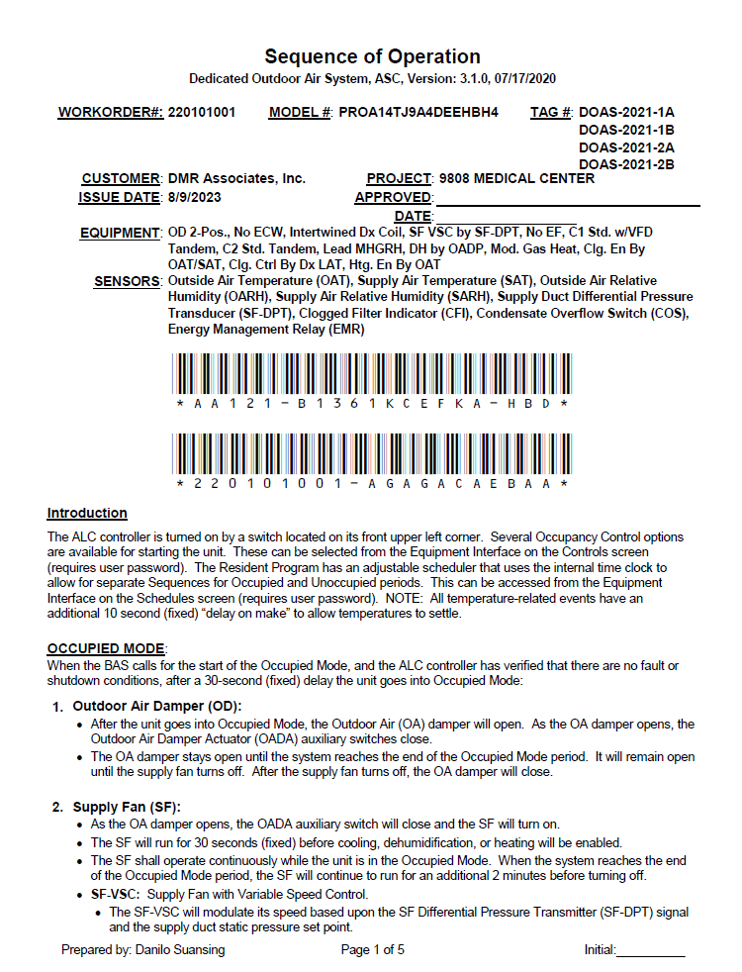
Sequences of Operation
Addison’s Sequence of Operation is generated dynamically based on equipment code string
Standard set of control methods are written (enabled) to the control program at the end of the production line
Custom ‘special’ Sequences can be generated by Addison Controls Engineering, at cost

Slide 29
One More Thing…
Notes:
Enabling network and software technologies will be added to the LS-1628u in 2024, allowing for an even more feature rich offering and competitive capabilities!

Slide 30
THANK YOU

