Slide 1
REP TRAINING
Frost Free Heat Pump Operation

Slide 2
Agenda
Electrification Solutions
- Heat Pumps
- Frost Free Air Source
Heat Pump
- Configurations
Frost Free Heat Pump Operation
Notes:
We will cover the motivation to electrify, areas currently effected by this trend, and potential product and systems to meet electrification needs.

Slide 3
DOAS: Heat Pumps
Cooling Mode
Compressor
Compressor
Heating Mode
Reversing Valve
Notes:
When our industry talks about heat pumps, we’re typically referring to reversing heat pumps.
Meaning, we control the refrigerant cycle to generate either heating or cooling outputs.
The mechanism most often used to do this is a reversing valve . Called such because it reverses the flow of refrigerant through the heat exchangers depending on which mode of operating its in (heating or cooling).
Shown here, you can see the refrigerant always flows through the compressor in the same direction, it’s the reversing valve that coordinates flow direction through the system.
Definitions:
Load HX is the indoor coil: evaporator when cooling. Condenser when heating
Source/Sink H-X is the outdoor coil: sink (condenser rejection of heat) when cooling mode. Source (evaporator – enthalpy -capacity) when in reverse heating mode

Slide 4
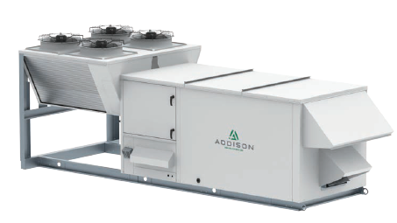
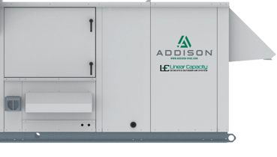
Electrification Solutions: Heat Pump Products
Air Source Heat Pump – Packaged RTU
Water Source Heat Pump – Packaged RTU / Indoor
Complete packaged rooftop
Electric cooling / heating
Dual refrigerant circuits
DDC controls
460, 208-230, 575 v
Outdoor / Indoor units
Electric cooling / heating
Dual refrigerant circuits
DDC controls
460, 208-230, 575 v
Notes:
Since this is a pdh course , not mfg specific then not mentioning :
FrostShield: Phase I is 18 - 70 ton Phase 1a is 3- 18 tons with Mitsubishi gas injection compressor all at 0F; next phase is -20F
WSHP: current offering 3 - 80 ton

Slide 5
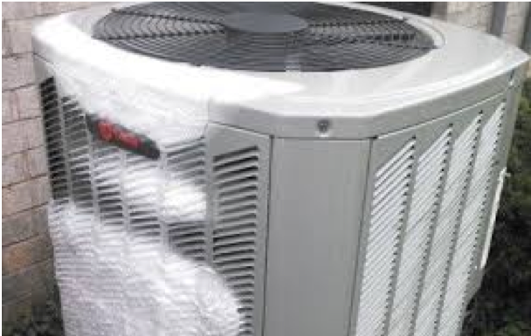
Old Challenges
Heat Pumps Have a Mixed Reputation Due to .Older Technology and Misapplication / Sizing
Lower Ambient Limitations On Equipment .Operation
Lower Ambient Conditions Require Increased .Defrost Cycles
Defrost Complicates Operation and Increases .Energy Usage

Slide 6
Old Challenges
34 / 29.1°F DB/WB ; 20.6°F Dewpoint
24° F
Defrost Strategies:
Reverse Cycle
Multiple Circuits: sequence reverse cycle per circuit
Result:
Cold Air Introduction to Occupied Space
Action:
Emergency/Auxiliary Heat, Electric KW
34° F
Source Coil ~ 20°F
Notes:
Multiple Circuits: sequence reverse cycle per circuit – still cold air intro because 1 circuit is defrost ( cooling and maybe a desuperheater coil for a gain of 8F) and the other coil in heat pump mode but struggling to produce heat as the coil is frosting over – lack of good heat transfer.
Bottom line cold/cool air to occupied space

Slide 7
So…What If The Heat Pump Never Had To Defrost?

Slide 8
Frost Free Operation
Simple Technology: Only Adds One New Gas Injection Valve and Some Additional Sensors
How It Works:
In Heating Mode, the Controller Begins to Monitor Outdoor Temperature and Dewpoint
Once the Evaporator Leaving Gas Temperature Starts to Dip Below the Point Frost Will Form, a Small Amount of Hot Discharge Gas Begins to be Injected
The Amount of Discharge Gas Injected Will be Increased or Decreased Based on Evaporator Leaving Gas Temperature
Coil Temperature Will be Maintained Just Above the Point Where Frost Would Form

Slide 9
FrostShield – The Ultimate Return on Air
FrostShield has extensive benefits to both the owner and the utilities
Owner Benefits
Utility Benefits
Fits electrification and decarbonization initiatives
Electrical construction costs are dramatically reduced
Lower energy usage costs
Reduction of the winter peak demand charge
Lower required energy usage on the grid
Reduction of peak heating demand in winter
Less required service to each building
Lessens grid overhaul needs

Slide 10
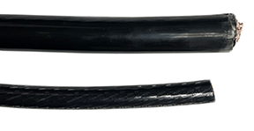
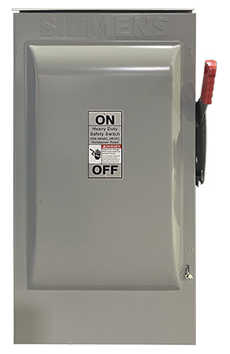
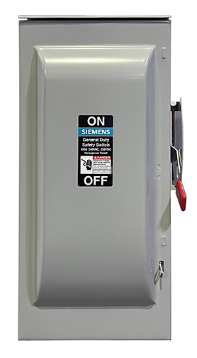
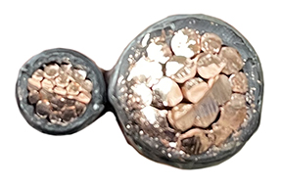
Better total cost of ownership
Smaller Electrical Service
Smaller Components
Reduced Wire Size
Reduced Size/Cost
200AMP
200AMP
8”D
100AMP
100AMP
6”D
2GA Wire
100AMP
3/0 Wire
200AMP
23”T
31”T
Heavier wire is more difficult to work with in both the production and installation of equipment
11”W
16”W

Slide 11
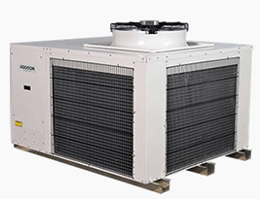
Frost Free Heat Pump Operation
34 / 29.1 F db/wb ; 20.6 F dewpoint
Preventative Action: Inject Hot Gas to raise the source coil above dew point
20°F source coil + 4°F = 24° F source coil
24°F DB
34°F = dry bulb ambient
Continuous Heat Pump Operation
34° F DB
20°F coil temperature
≈ 20.6° F dew point
Frost form

Slide 12
100% DOAS – Design Considerations:
Preheat is required unless the EAT ≥15°F to load heat exchanger (indoor coil)
Electric heat
Hot water heat – central plant ? run around loop ?
Final supply discharge air temperature, Emergency / Auxiliary heat
Selected for full range of Temperature Difference
Electric 150 KW, MOCP = 200 A
Heat Pump + 50 KW trim, MOCP = 300 A
Heat Pump + 50 KW trim w/ “Lock Out”, MOCP = 175 A
Unit design: MCA = 180 A and MOCP 200 A
Notes:
Electric heat controls: current std scr controls are such that 20% of capacity still yields 100% ampacity draw. So, of the 150 kw with mocp of 200 Amps still means at 40 kw trim there is a MOCP rating of 200 amps ( FLA ~ 180 amp). This is an impact on overall unit seq of op and unit total MOCP.
Seq of Operation:
Heat pump operation MOCP = 175 A ( need to discuss why full electric heat: hp failure and weather point)
heat pump plus 40 kw trim MOCP = 300 A
Electric kw 100% MCOP = 200 A
Customized electric heat controls offers a ‘lock out’ technology to offer drawing amps only what is needed or determined as max kw req’d for supplemental and remainder of electric heat is ‘locked out’ from energizing.
4. Heat pump plus 40 kw trim with ‘lock out’ technology is MOCP =175 A – impactful in reducing electrical costs vs a 300 amp MOCP
Unit design mca 180/ mocp 200 as worse case ( need to discuss why full electric heat: hp failure and weather point)

Slide 13
Mixed Air – Design Considerations: Offset heat loss
Supply Air Temperature to Offset Space Heat Loss:
Heat pump operation plus terminal reheat
Auxiliary electric heat integral to unit (constant temp = all zones)
How is Emergency / Auxiliary Heat Sized, “it depends” ……..
How much terminal / duct heat is available?
Heat pump capacity ?
Plan B for heat?
Enthalpy Wheel:
Can we introduce ?
Increase overall Mixed Air Temperature.
Notes:
Mixed air offset heat loss - Supplemental electric heat integral to unit (constant temp = all zones)?
OR heat pump duty delivered to zones and trimmed out at terminal box w/ reheat for final temp control to offset heat loss. ( better for vav and muiltiple zones)
Single unit multi zone can we have zone sensors that feedback - max qty 5 ZS contrls to average temp feedback or worse case ( worse case should be critical as might end up over heating other zones)
Emergency / Aux heat – in this example the fall back plan B operation to satisfy space heat loss should mechanical heat pump perf lost: mixed air at 55F + unit post heat 50 kw 10F rise = 65F discharge + terminal reheat ( don’t know specific term box reheat avail to comment on disch temp)
Enthalpy Wheel:
Can we introduce ? More OA better if we gang enough RA back( ≥50% is code )
Increase overall Mixed Air Temperature.

Slide 14
Enthalpy wheel 100% OA – Design Considerations
Enthalpy Wheel:
VFD defrost is recommended
Increase wheel ( diameter / thickness ) for improved performance
Energy Recovery: return airflow CFM impacts performance
Include Emergency / Auxiliary Electric Heat:
Selected for full range of Temperature Difference
Electric 150 KW, MOCP = 200 A
Heat Pump + 70 KW trim, MOCP = 300 A
Heat Pump + 70 KW trim w/ “Lock Out”, MOCP = 175 A
Unit design: MCA = 180 A and MOCP 200 A
Notes:
ECW - Pre-treat Outside Air through exhaust air energy recovery ; compliant Std 90.1
Increase wheel size ( diameter and thickness) can net you more performance 3F-5F . It is a trial of diminishing returns as we flat line on perf and increase wheel and cost . Last point, RA CFM - “more the better “ for performance but driven by avail RA and space pressurization
Seq of Operation:
Heat pump operation MOCP = 175 A ( need to discuss why full electric heat: hp failure and weather point)
heat pump plus 70 kw trim MOCP = 300 A ( there was 18kw, 50 kw, used 70 kw wheel failure as max cutoff)
Electric kw 100% MCOP = 200 A
Customized electric heat controls offers a ‘lock out’ technology to offer drawing amps only what is needed or determined as max kw req’d for supplemental and remainder of electric heat is ‘locked out’ from energizing.
4. Heat pump plus max 70 kw trim with ‘lock out’ technology is MOCP =175 A – impactful in reducing electrical costs vs a 300 amp MOCP
Unit design mca 180/ mocp 200 as worse case ( need to discuss why full electric heat: hp failure and weather point)

Slide 15
Oversized unit – Design Considerations
Oversized unit MOCP 110 A
Lower unit and building electrical requirements
Lower building electrical → lower first costs and installed costs
Existing and Retrofit buildings
Oversized Units for No Emergency / Auxiliary Heat Required :
Lower apd → lower tsp → lower BHP = fan operating cost savings
Cooling becomes ‘coincident’ with coil dewpoints low(er)
With lower supply humidity ratio, DOAS is a complete and total dehumidification
Notes:
Existing and Retrofit buildings do not have the electrical service available to begin with so this might allow an existing building to not have to request an upsize in their electrical feed. You are talking big dollars to upsize feeds, or run power cabling large bldg.
Cooling becomes ‘coincident’ with coil dewpoints low(er) – ensure design uses compressor unloading to match load, use vfd lead compressor on lead circuit, first on last off
With lower supply humidity ratio, DOAS is a complete and total dehumidification MEANS very possible of offset all latent loads: people, infiltration, & permeance. Great for high occupany applications k-12 , higher ed, places of assembly, church, conference. And retrofits jobs where infiltration loads might be high.

Slide 16
Agenda
Wrap Up
Frost Free Heat Pump Operation
Notes:
We will cover the motivation to electrify, areas currently effected by this trend, and potential product and systems to meet electrification needs.

Slide 17
Frost Free Heat Pump Operation – Final Design Considerations
Oversize could be applied for any of the applications reviewed
First cost of equipment increases
What is Plan ‘B’ for heat
Heating load may drive the unit selection; cooling delivered is “coincident”
Water Source Heat Pump, DOAS
Heat Pump operation ‘Disabled’ :
equipment failure
weather DP ≈ DB

Slide 18
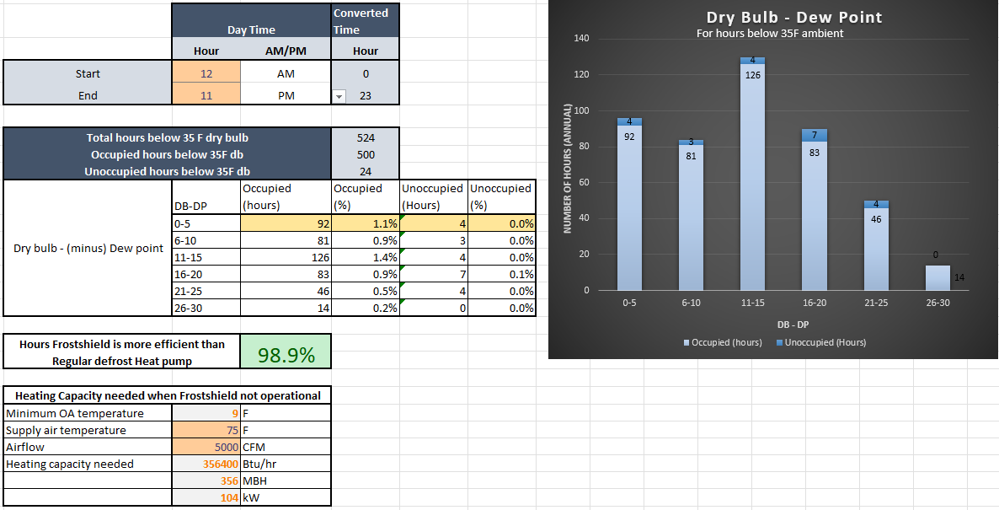
Frost Free Heat Pump Operation
33 / 32.9 °F db/wb ; 32.8 °F dewpoint
Preventative Action : Inject Hot Gas to raise the source coil above dew point
19°F source coil + 17° F = 36° F source coil
33 °F = ambient
23 F DB
FrostShield is limited
Heat Pump operation is ?
Aux/Back Up heat is ?
33 F DB
19° F coil temperature
< 32.8 °F dew pt
frost form

Slide 19
FrostShield™ Specifications

Slide 20
FrostShield™ Equipment Schedule

Slide 21
Summary to ASHP in Low Ambient Operation
Compressor Lift
Defrost Management:
Operation with Defrost Sequence of Operation
Operation without Defrost
Electrical, single point power

Slide 22
Introducing FrostShield

Slide 23
Thank you!

