Slide 1
REP TRAINING
Guide Specifications, Competitive Matrix, & the Unfair Advantage
Notes:
Each slide:
what does the rep get out of this
Best way to describe it with choice words
Comments:
See more examples
What is the value of it
Shows pricing of difference
20-30 minutes

Slide 2
Guide Specification: PR series

Slide 3
GUIDE SPECIFICAITONS
Notes:
- Items in margin will have engineering merit or selling merit (bot good for Addison)
Can go through each and give an example on how it will help them briefly
First one: compressors warranty: competitor is 1 year and would be a cost add for 5 years. This is a standard for Addison.
Letting competitors off the hook that don’t have this. Reps need to make engineers aware of this so competitors have to have this in the package.

Slide 4
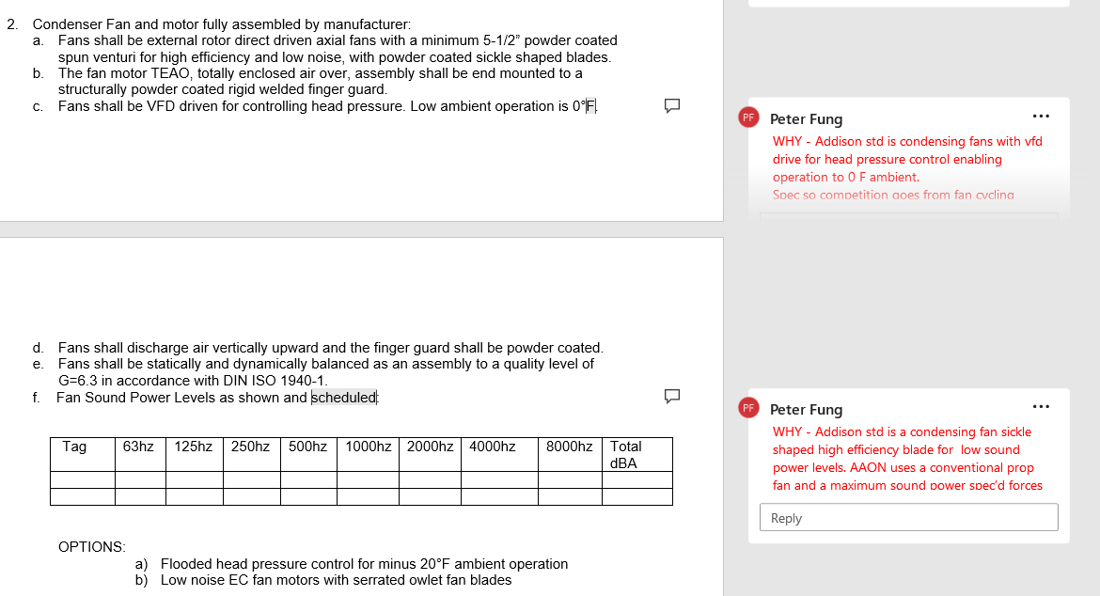
GUIDE SPECIFICAITONS
Notes:
Same of last slide.

Slide 5
Competitive Matrix

Slide 6
Where to Find This Information

Slide 7
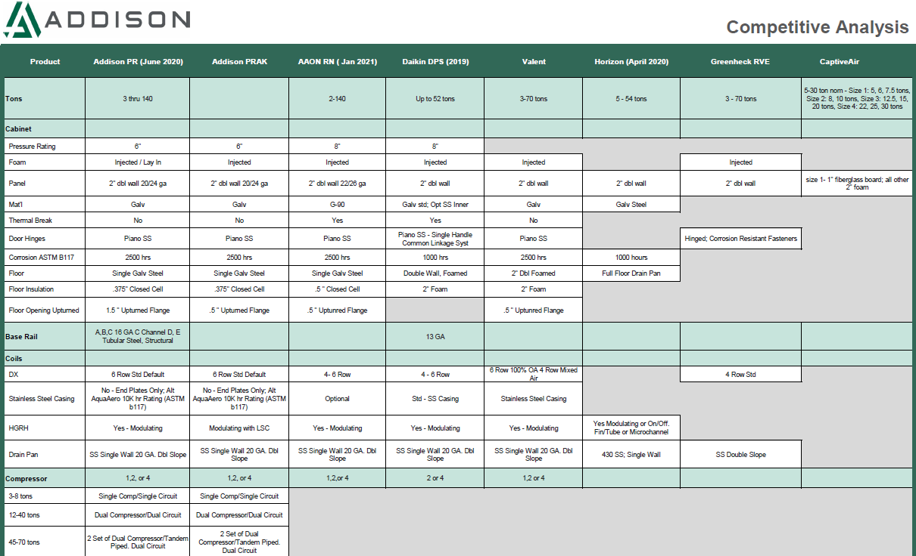
Competitive Analysis
Notes:
Each manufactory is profiles here
- Data is from 2020 or newer
For this and guide specs that I just went through is Great for completing a spec compliance (c for compliance, E for exception, D for deviation)
Can go through a couple for examples

Slide 8
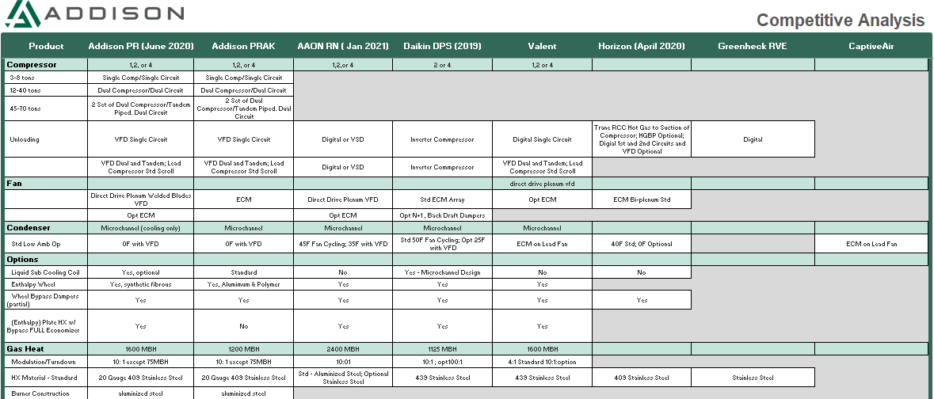
Competitive Analysis
Notes:
Ask if anyone ever read the IOM for competitors or our own IOM. Can learn a lot about our units and other competitors units.

Slide 9
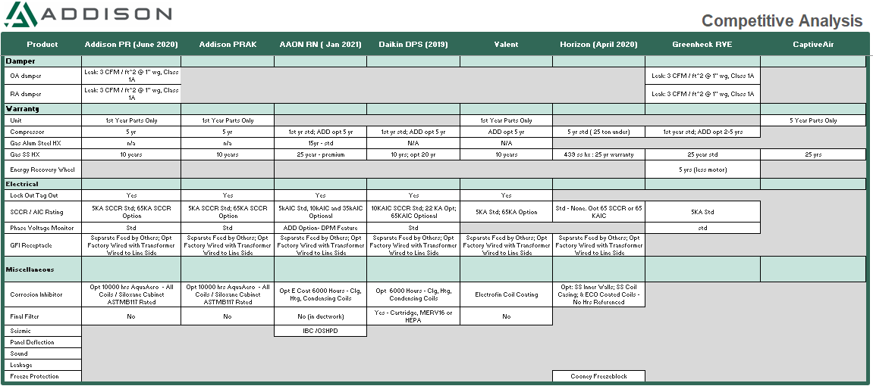
Competitive Analysis
Notes:
Help us fill the holes in this data if you see anything out in the field.

Slide 10
Unfair Advantage

Slide 11
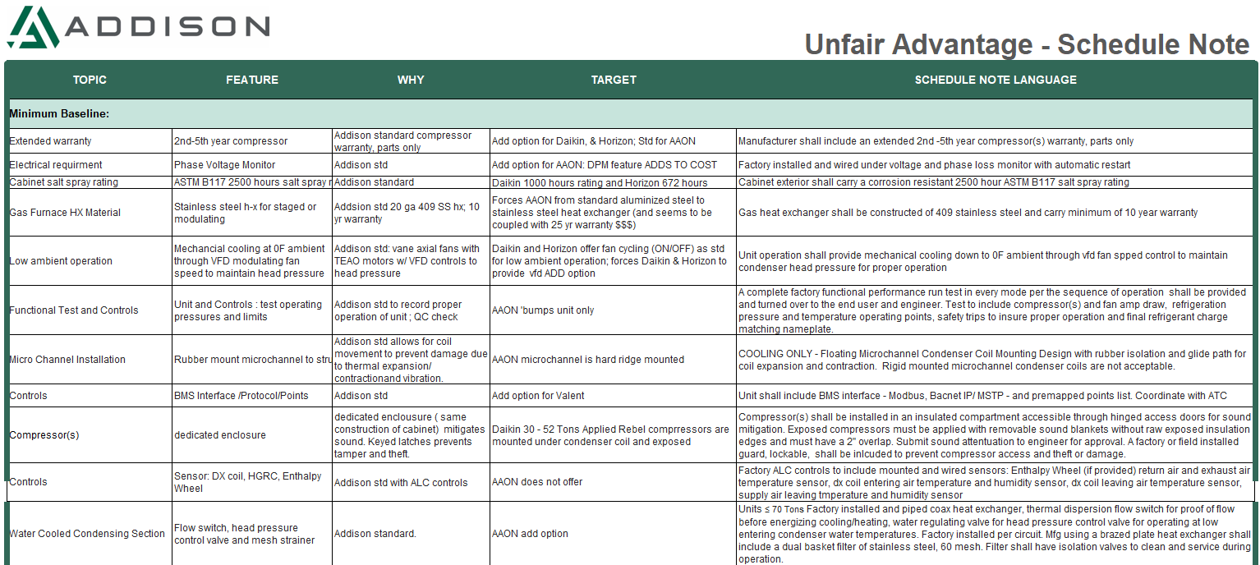
Unfair Advantage – Schedule Note
Notes:
Shows all of Addison's selling advantage
Still allows other manufactures to bid the project but cause them to throw more money at the unit to comply with addison units.
Schedule notes follow the job all the way through the process. Specs can get overwritten or replaced by a master guide spec.
These are great for schedule notes. They are not written so this is why it is important to bring to the engineers.
Examples to do:
2nd- 5th year compressors warrantiy
Ask trinity what the price add would be to share with everyone to show how the competition would have to add this.
Water cooled:
Flow switch and heat pressure controls

Slide 12
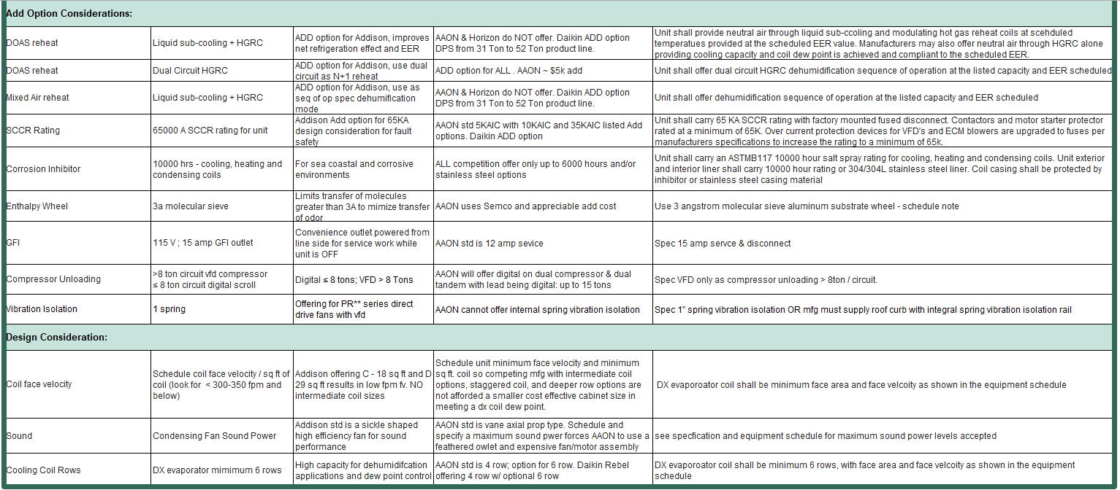
Unfair Advantage – Schedule Note
Notes:
These will be a cost add but our competitors will have a harder time (more money) to comply with these options. 65K SCCR
Examples:
65K SCCR:
This would be for the entire Addison unit not just the disconnect (other manufactors only do disconnect)
Show add for this through ACE

Slide 13
Thank you!

