Slide 1
REP TRAINING
Splits – MC/MA

Slide 2
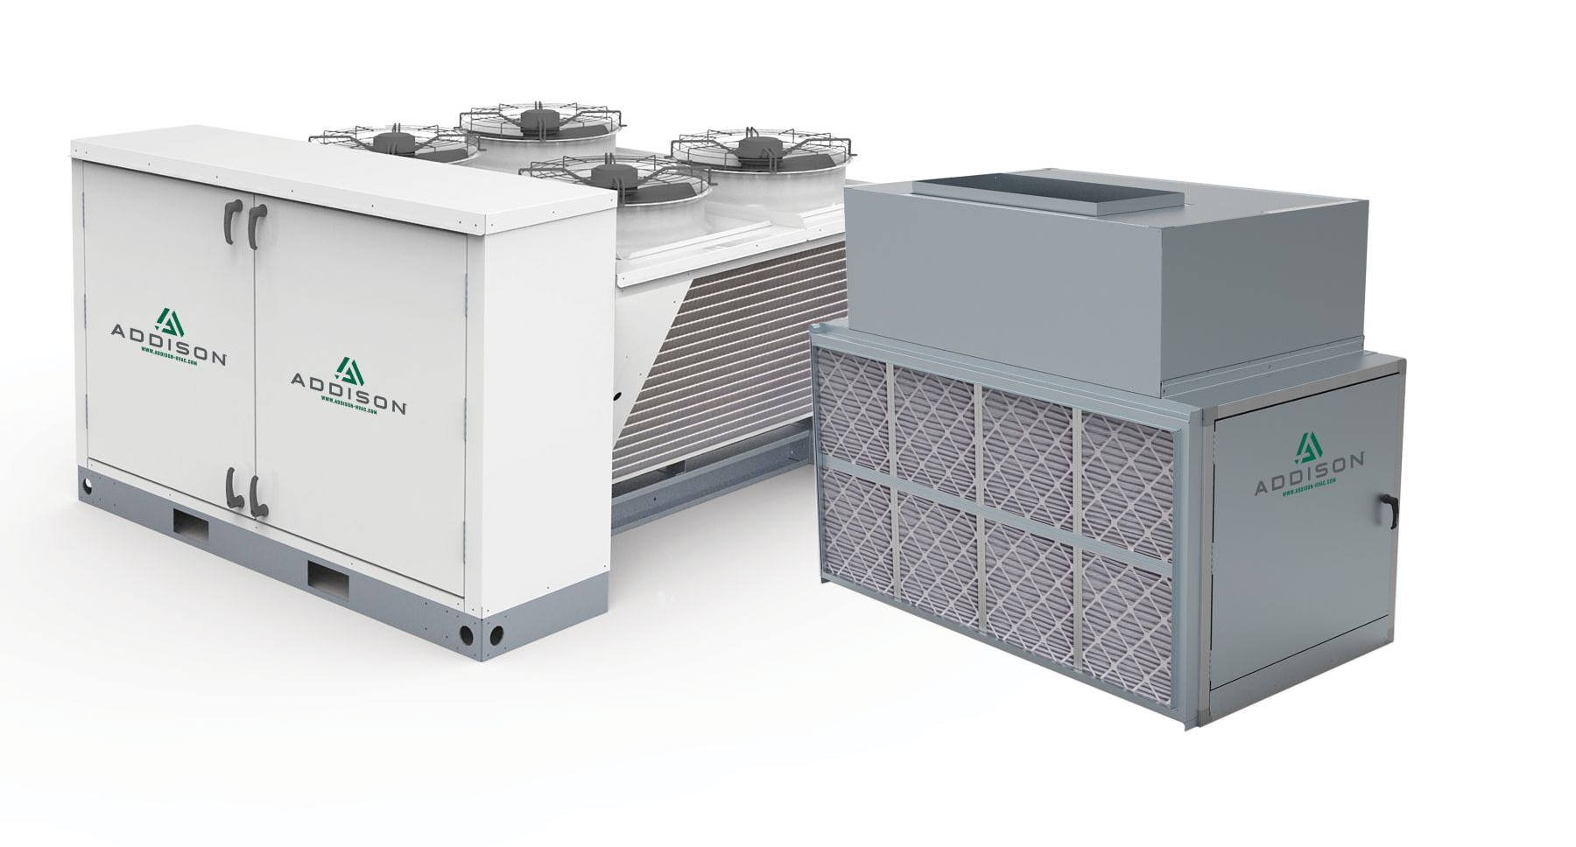
Learn to Love Splits
WHY?

Slide 3
MC/MA
Capacity from 3.5 - 80 Tons
Optional Heat Pump Operation
Airflow from 500 - 15,000 CFM (Outdoor Air)
Hinged, Double-Walled Access Doors
6-Row Intertwined Air Coils
Modulating Reheat Circuit
Switchable SubCooling Circuit
Scroll Compressors (Optional Lead VFD) INVERTER COMPRESSOR
All-Digital Controls with BAS Integration
Direct Drive EC Plenum Supply Blowers
Aluminum and Galvanized Steel Cabinet
MicroChannel Condenser Coils
Direct Drive EC Condenser Fans
Multiple Service Access Points
Optional 10,000 Hour Corrosion Protection
Dedicated Outdoor Air or Recirculating Comfort Cooling Operation
2” Double-Wall Foam Insulated Construction (R-13)
Single circuit 042-072 Dual circuit 096-420

Slide 4
MC/MA
B CABINET
C CABINET
D CABINET
E CABINET

Slide 5
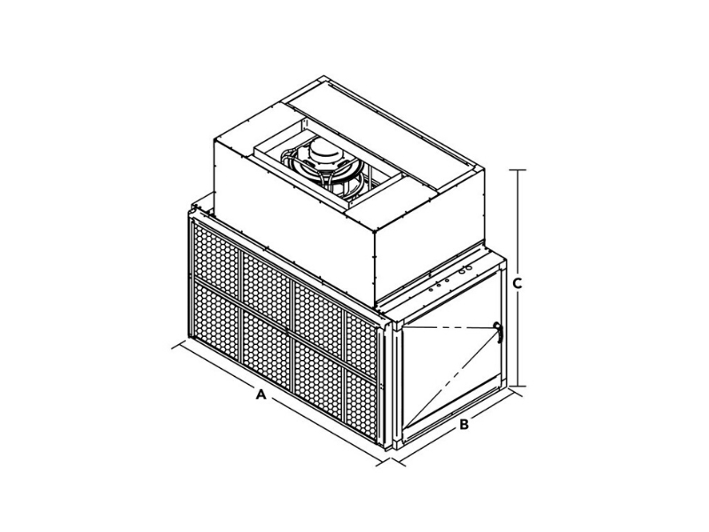
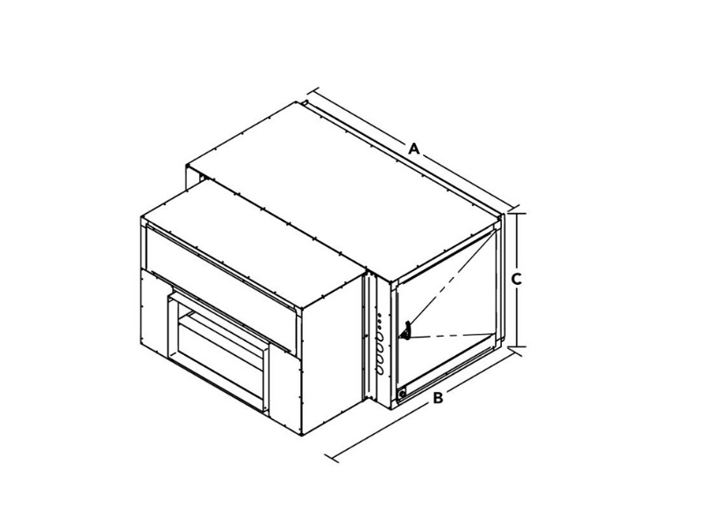
MC/MA
HORIZONTAL
VERTICAL

Slide 6
MC/MA

Slide 7
MC/MA

Slide 8
MC/MA

Slide 9
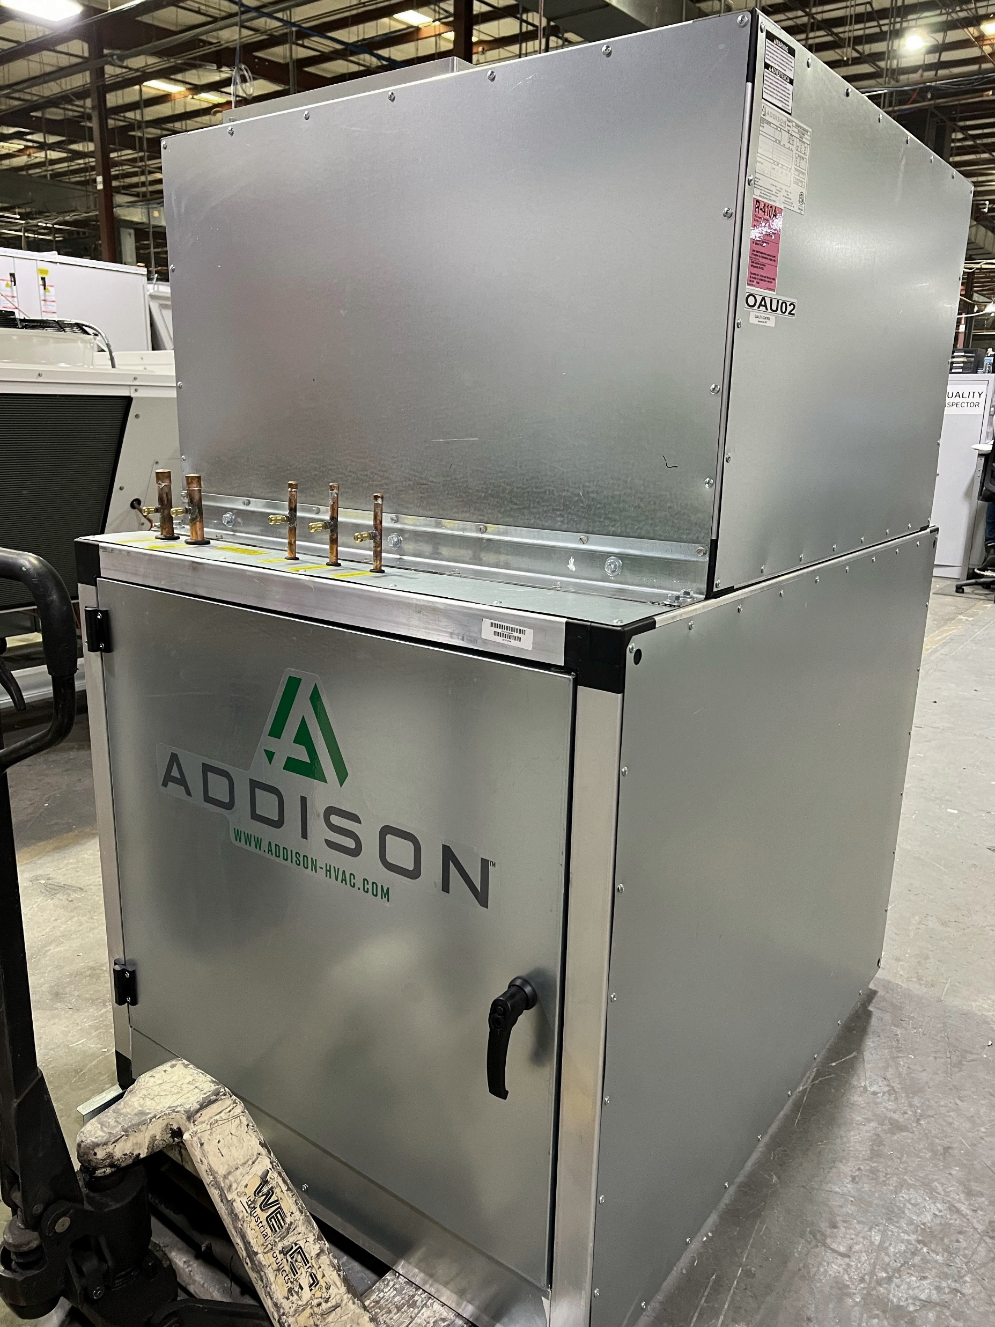
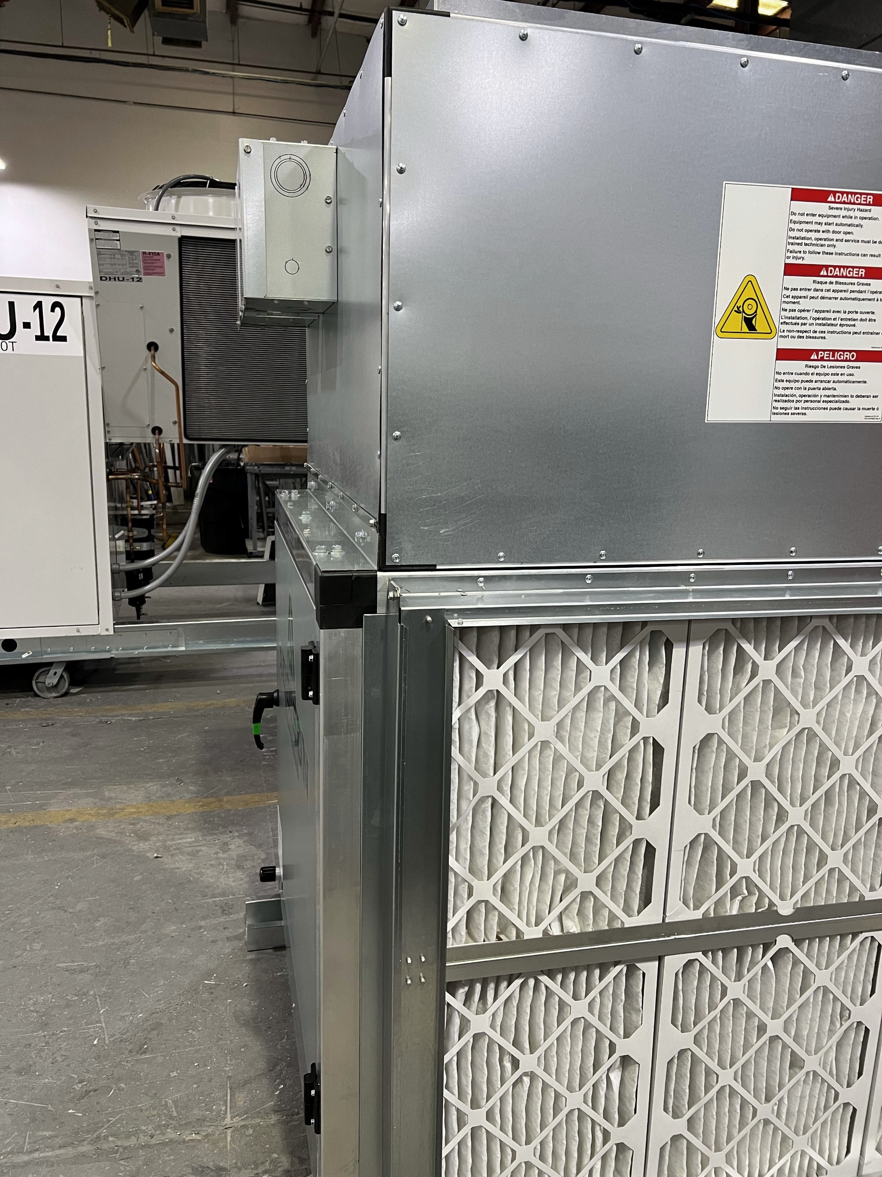
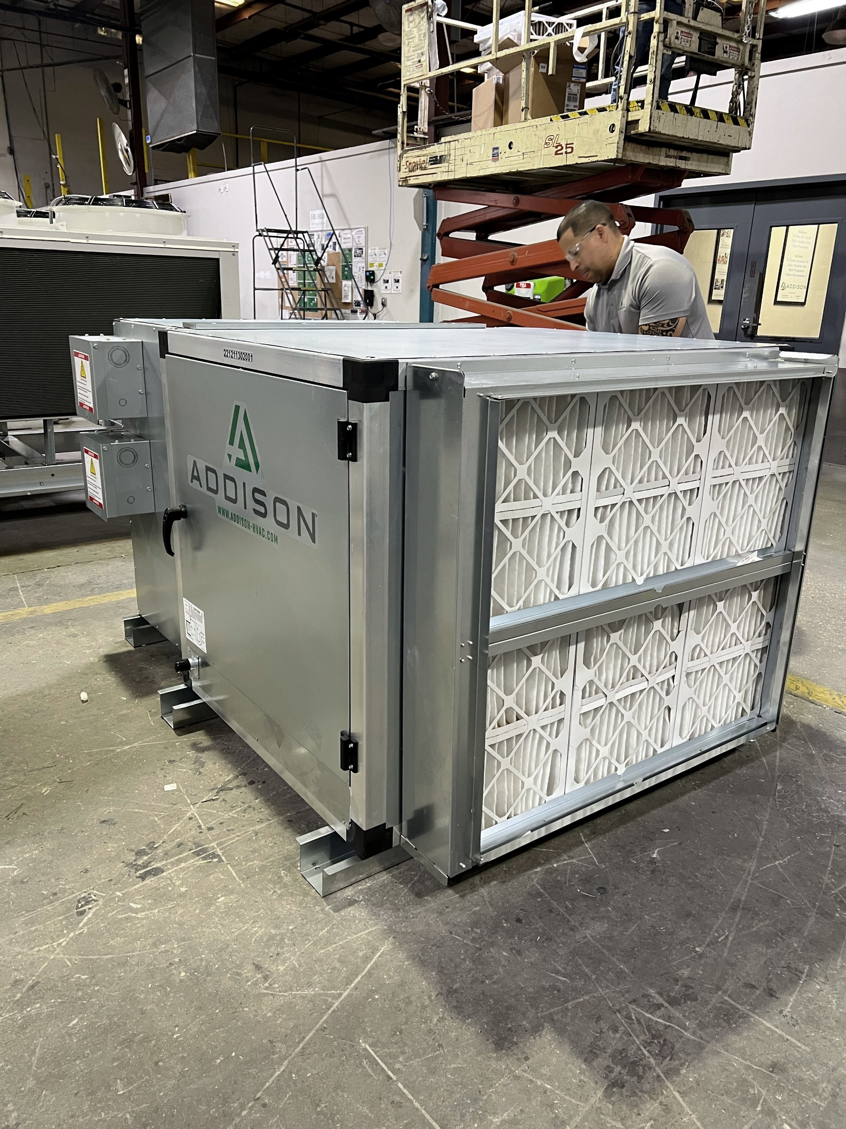
MC/MA

Slide 10
MC/MA Do’s and Don’ts
Do
Don’t
Verify the lengths before bid
Verify the pipe sizes
Contact Apps if you need sizing
Verify clearances IOM
Evacuate the system to 500 microns
Do complete start-up and document
Become knowledgeable about splits – READ OUR DOCUMENTS
You can add a mixing box for mixed air applications
Don’t assume the line length
Don’t assume the contractor knows
We don’t do heat recovery
Our units will NOT fit through a 36” door
Don’t call service without a report
Don’t exceed the recommended equivalent lengths. 100 feet for heat pumps, 150 feet for straight cooling
We do NOT offer heat recovery in splits

Slide 11
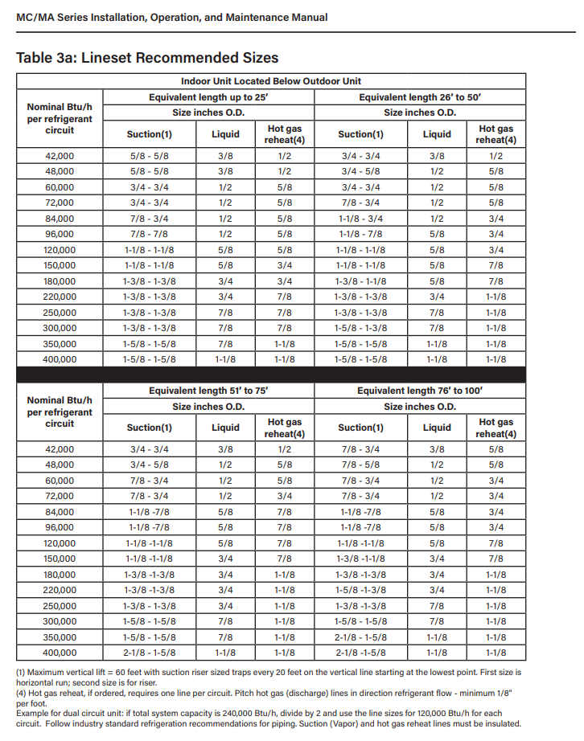
MC/MA

Slide 12
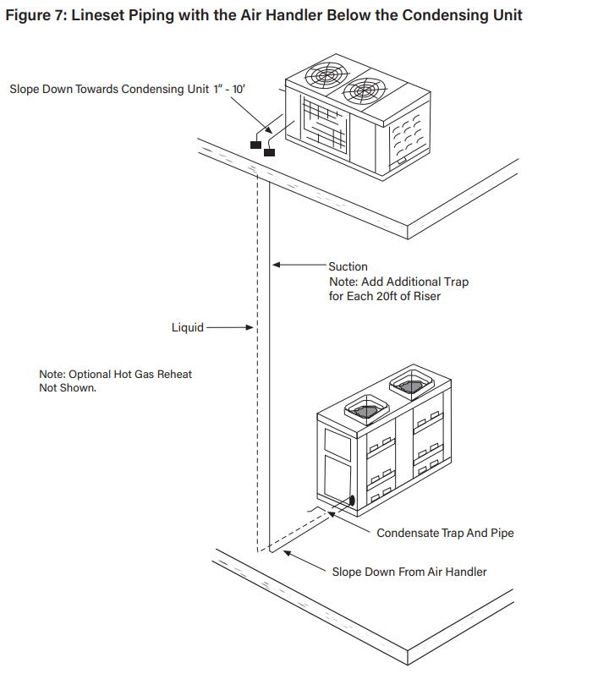
MC/MA

Slide 13
Thank you

