Slide 1
REP TRAINING
Model MI

Slide 2
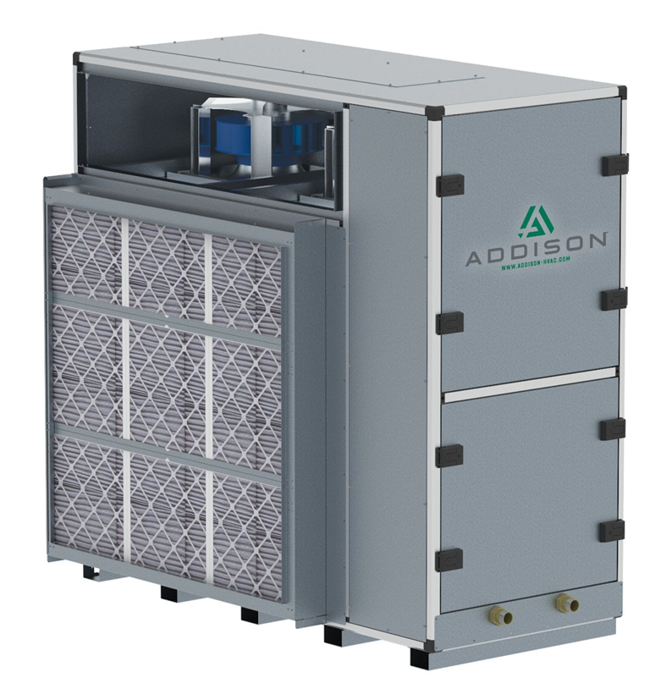
Model MI
CFM 1500-7000
Capacity of 10-45 Tons
6 Row Intertwined Coil
Switchable Subcooling
ECM Fans Only
Multiple Discharge Options

Slide 3
Model MI

Slide 4
Model MI

Slide 5
Model MI

Slide 6
Model MI

Slide 7
Model MI

Slide 8
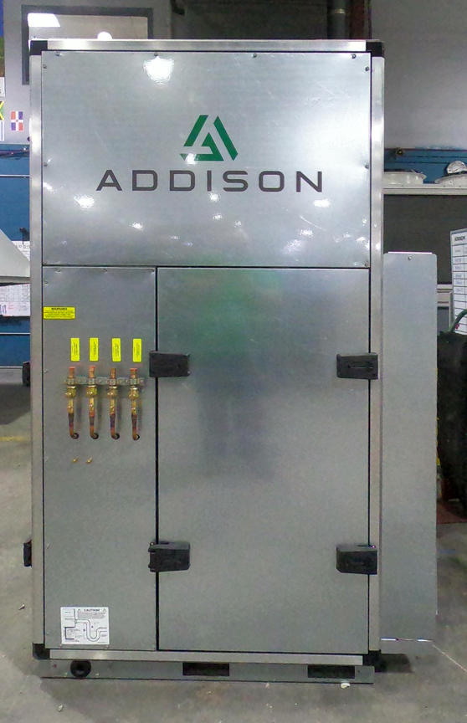
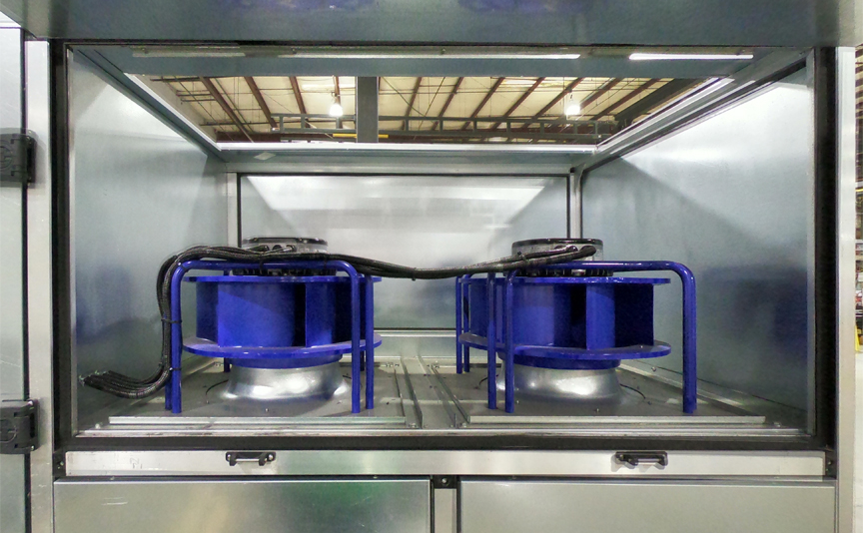
Model MI
2” Double Wall Construction
Air Cooled or Water Cooled
Pair with Our MC Condensers
Galvanized Construction

Slide 9
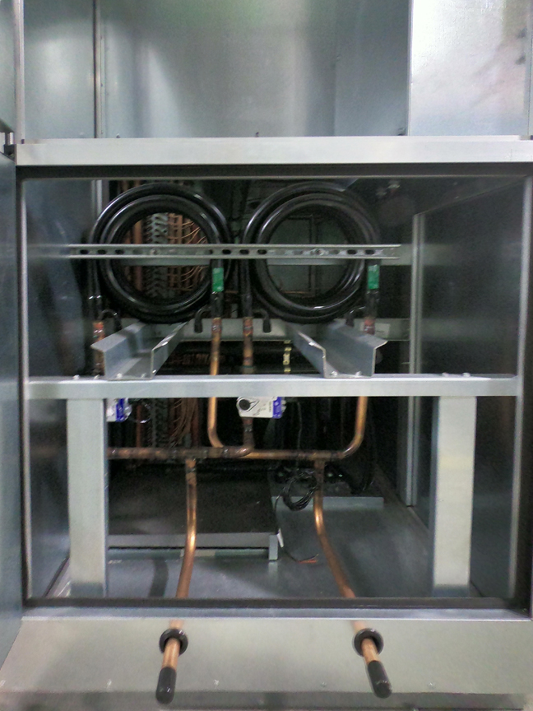
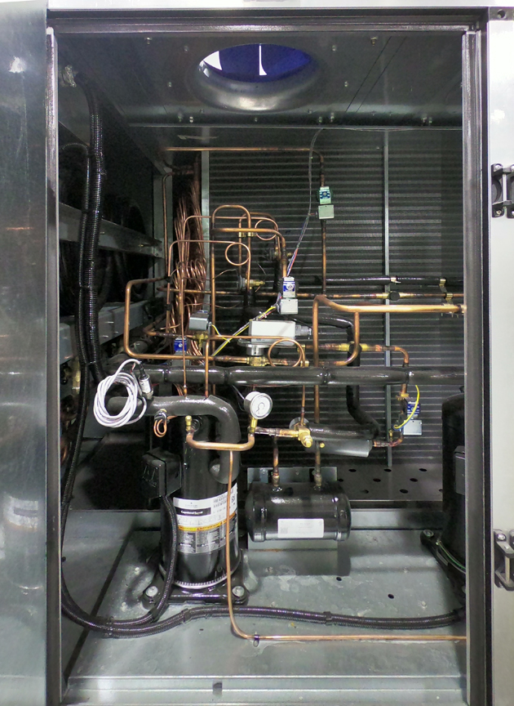
Model MI
Water Coils
Same Compressors as other Equipment
100% OA Unit or
Recirculating
Very Accessible

Slide 10
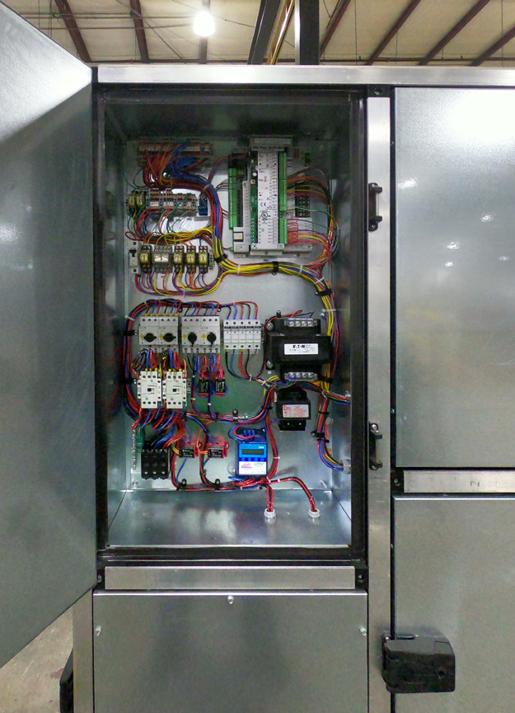
Model MI
BAS Controls
10,000 Hour Corrosion Protection Option
Water Coil Options for Pre-Heat
Two Cabinet Sizes – Won’t Fit Through Standard Doors

Slide 11
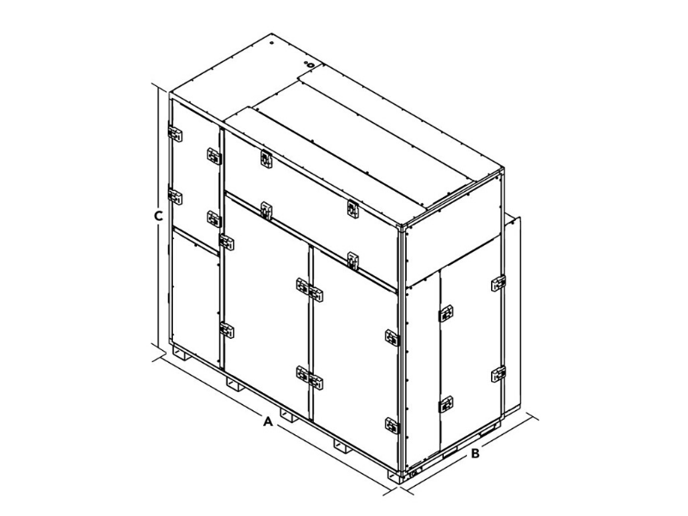
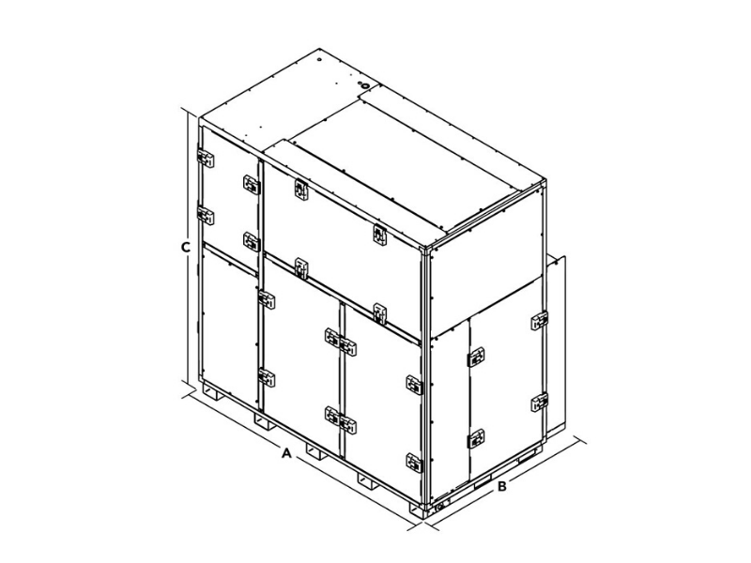
Model MI
NOT MODULAR
A CABINET
82.5 WIDE
53.25 DEEP
86 HIGH
B CABINET
99.5 WIDE
53.25 DEEP
96.25 HIGH

Slide 12
Where to use a MI Unit
Multi-Story Office Buildings
Schools
Water Source Heat Pump Jobs
Geothermal Jobs
Interior Spaces

Slide 13
THANK YOU

