Slide 1
REP TRAINING
DOAS, PROA, PRAK and LC Service Training

Slide 2

ADDISON TECHNICAL SUPPORT

Slide 3
ADDISON TECHNICAL SUPPORT DEPARTMENT CONTACTS
Addison General Office Phone: (407) 292-4400
Technical Support Specialist Ed Krikorian: (Ext.413)
Email: ekrikorian@addison-hvac.com
Technical Support Specialist Stephen Montville: (Ext.463)
Email: stephen.montville@addison-hvac.com

Slide 4
Technical Support
Always have model and serial number of units when calling or emailing.
Need to contact our tech support team for ALC program request changes.
Will need to fill out a form.
What is the normal turnaround time for ALC program change is 2 weeks from receipt of PO.

Slide 5
Technical Support

Slide 6
TECHNICAL SUPPORT
What are the frequent questions we get asked.
Literature
  Wiring Diagrams
  Installation Operation & Maintenance Manual (IO&M)
Size of Unit
Age of Unit

Slide 7
Technical Support
Assist in Determining Part Required
Assist with Diagnosing the Problem
Assist Field Service Tech at Start-up

Slide 8
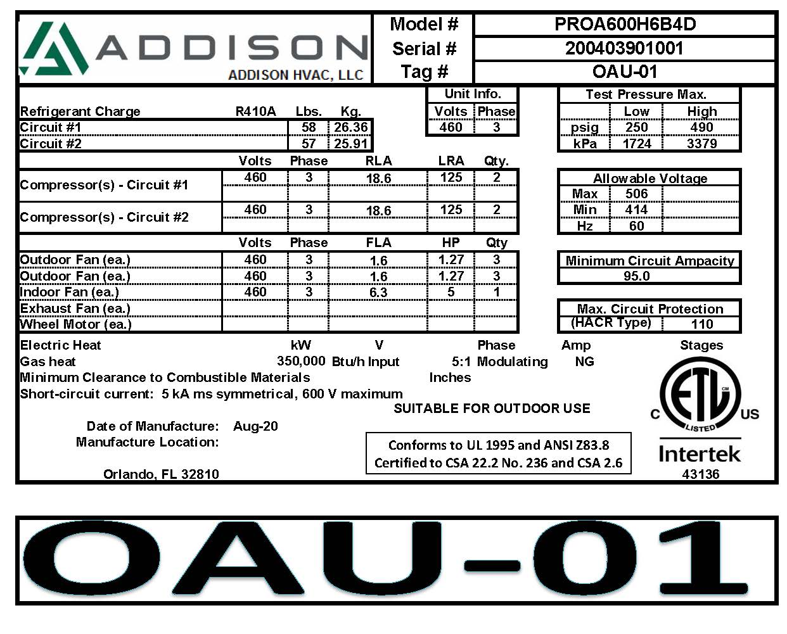
TECHNICAL SUPPORT REQUIRED INFORMATION
Serial Number
  Include break down (200403901001)
    First two (2) digits represent the year
    Second two (2) digits represent the month
Model & Serial Number From Serial Tag*

Slide 9
TECHNICAL SUPPORT OFFERS ASSISTANCE WITH…
Size of Unit
Age of Unit
Assist in Determining Part Required
Assist with Diagnosing the Problem
Assist Field Service Tech at Start-up

Slide 10
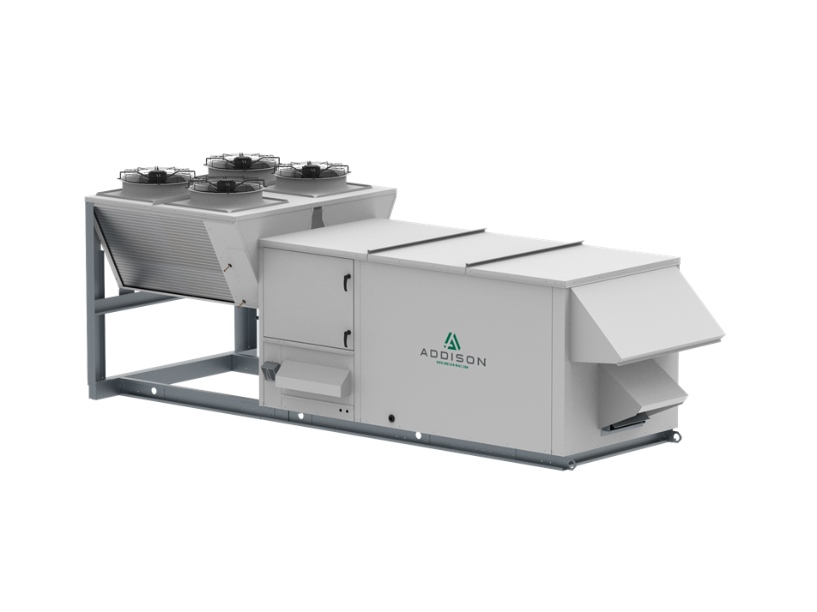
PROA STARTUP, TECH SUPPORT, AND SERVICE

Slide 11
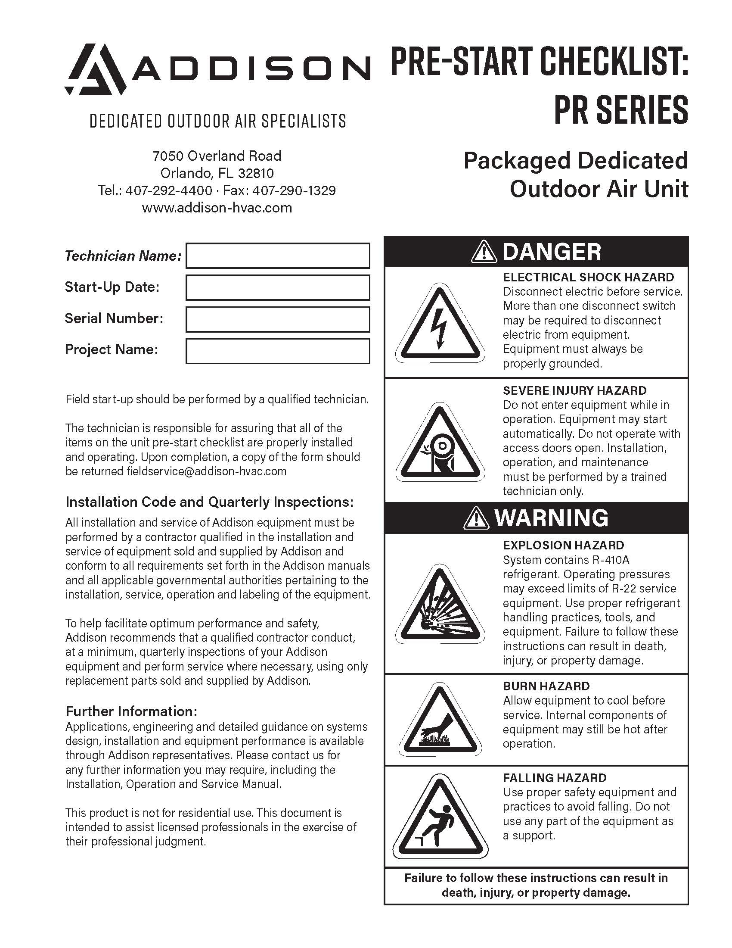
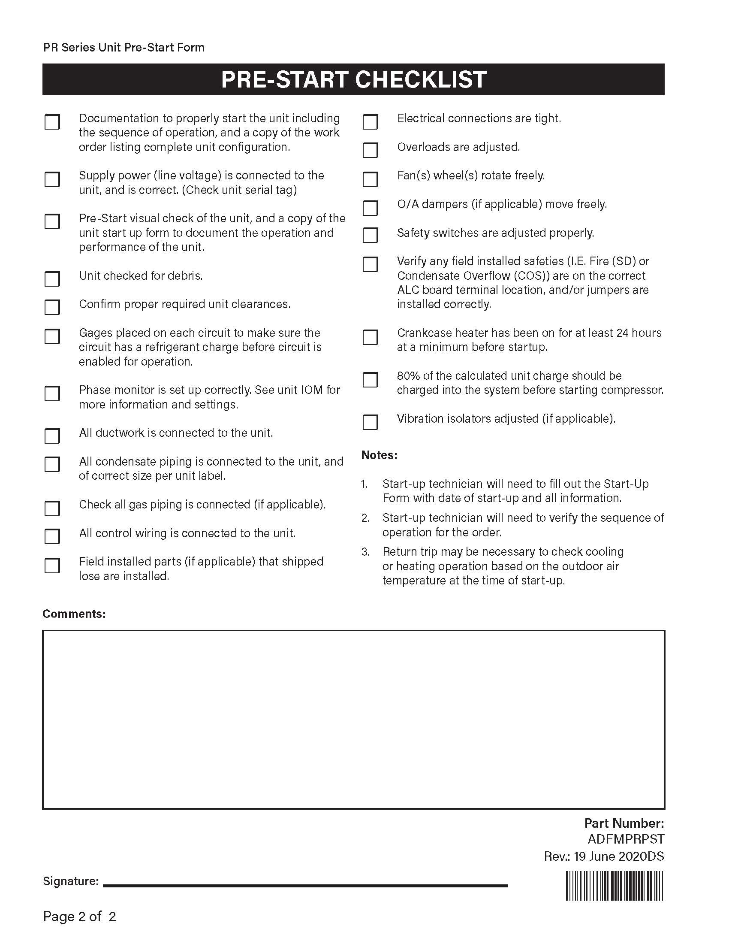
START-UP PRE-START CHECKLIST

Slide 12
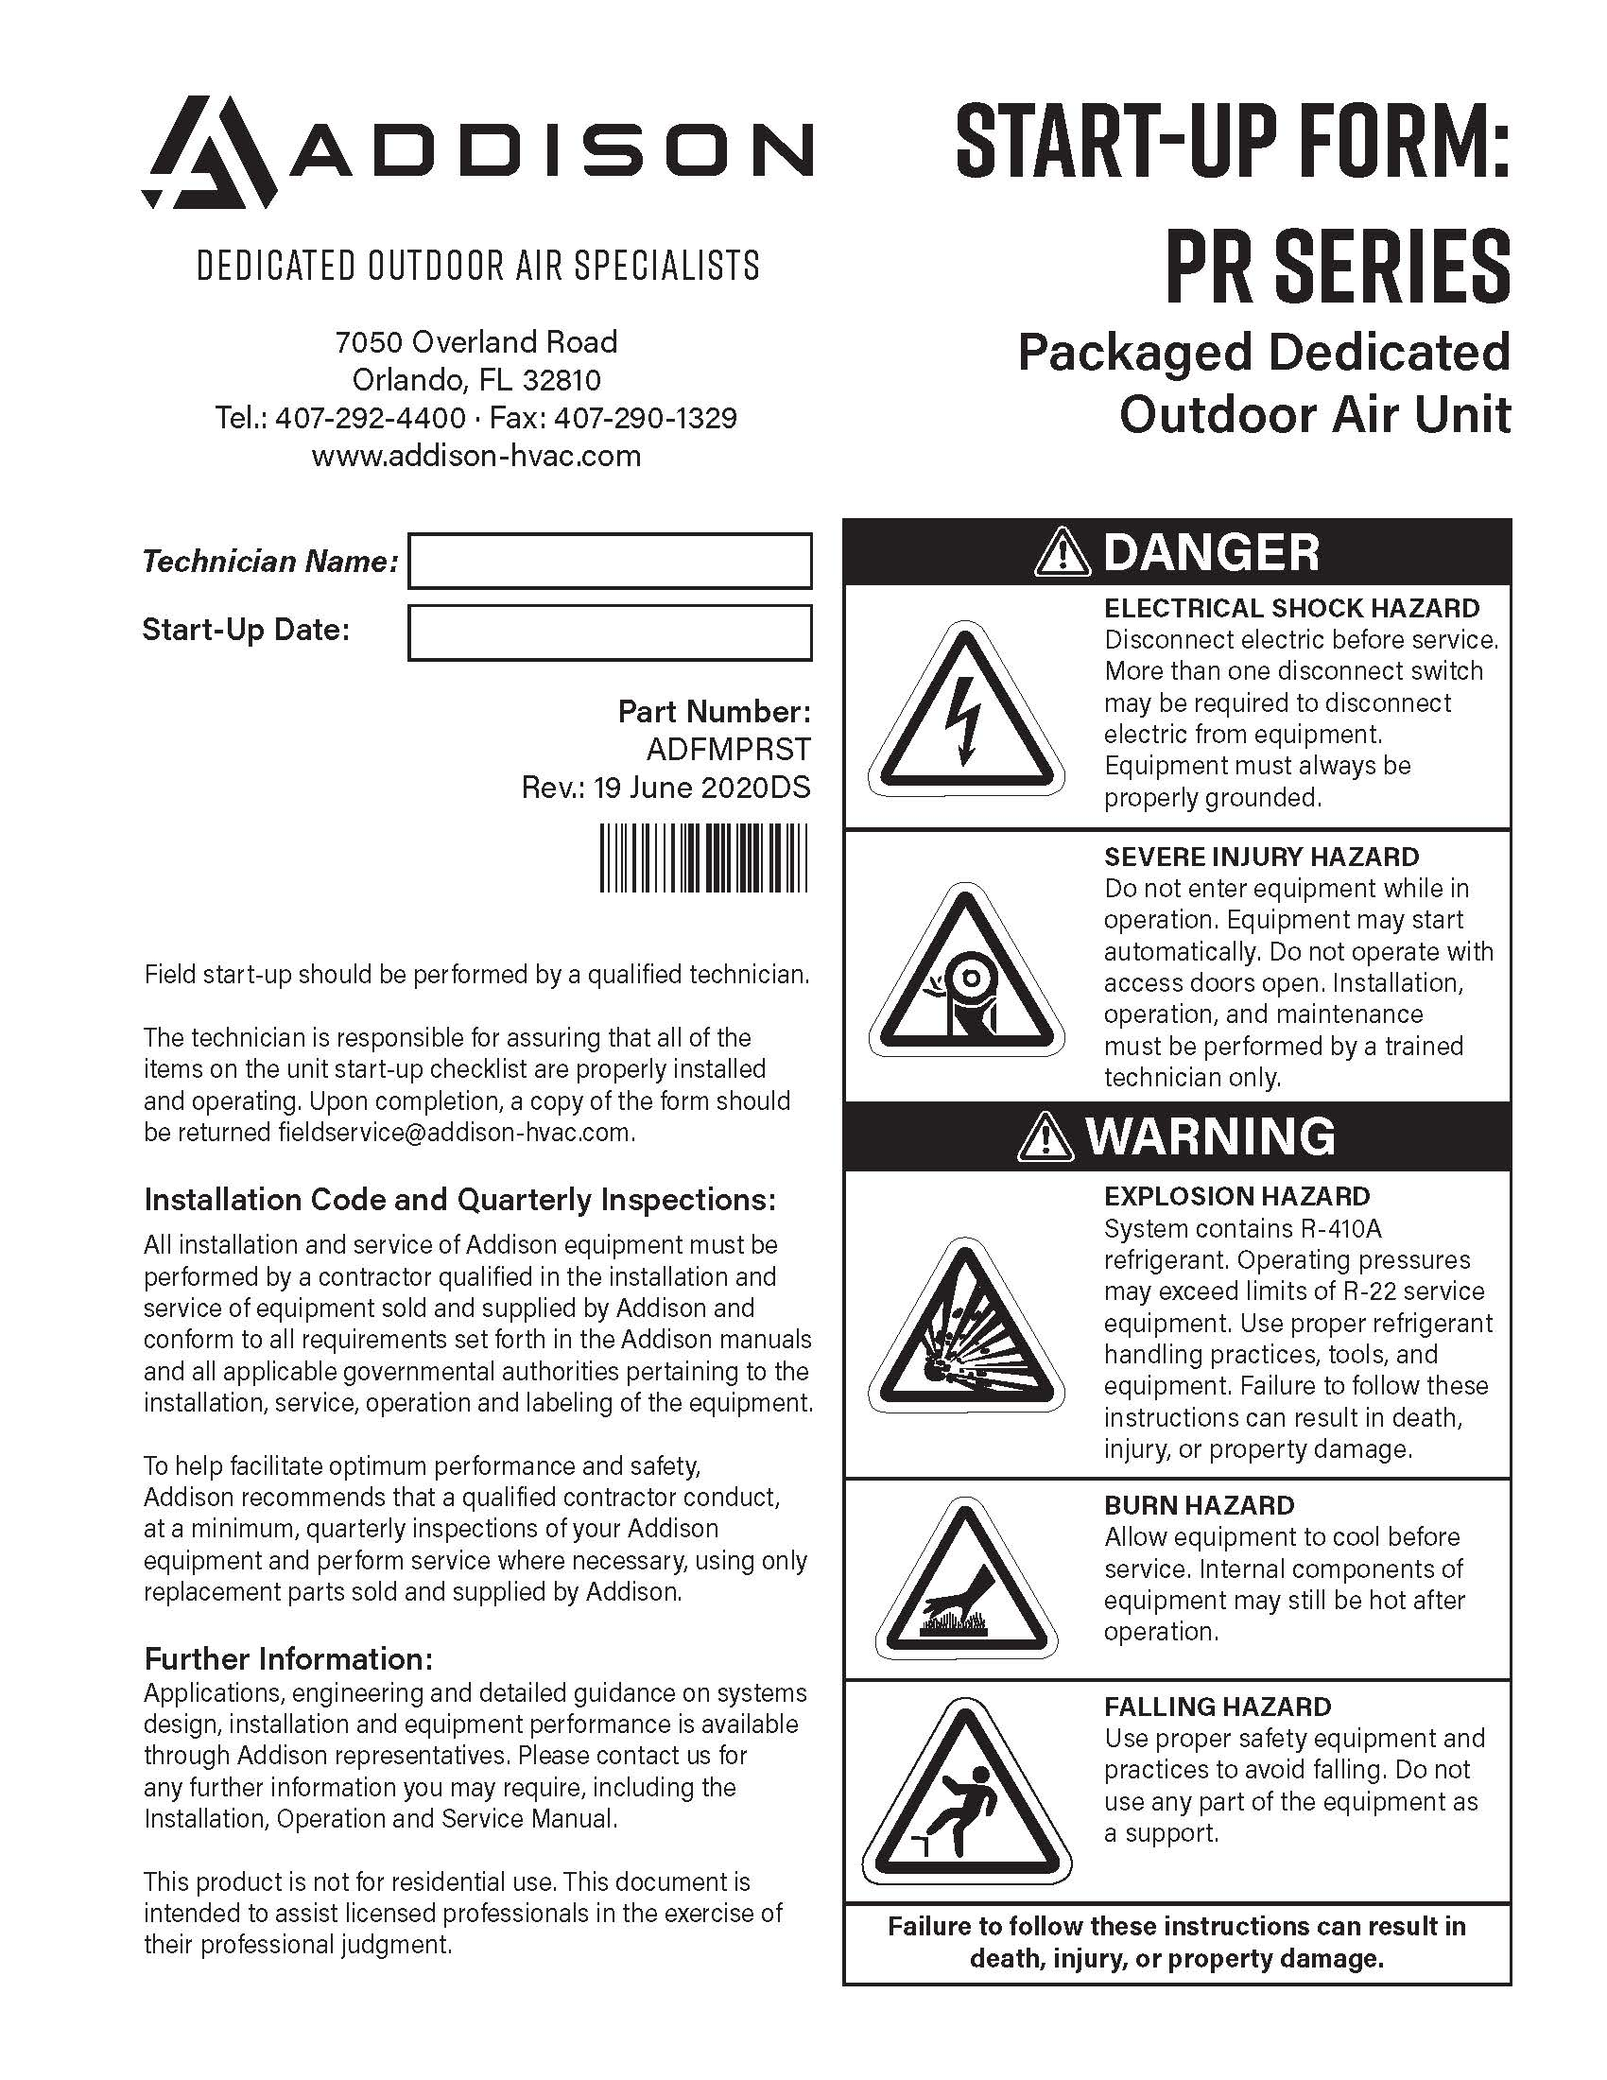
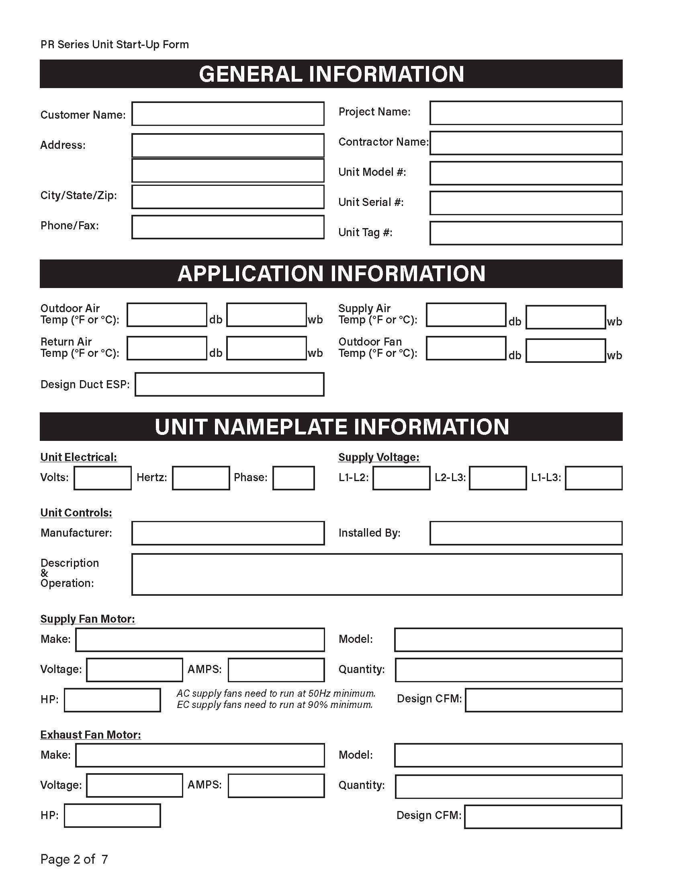
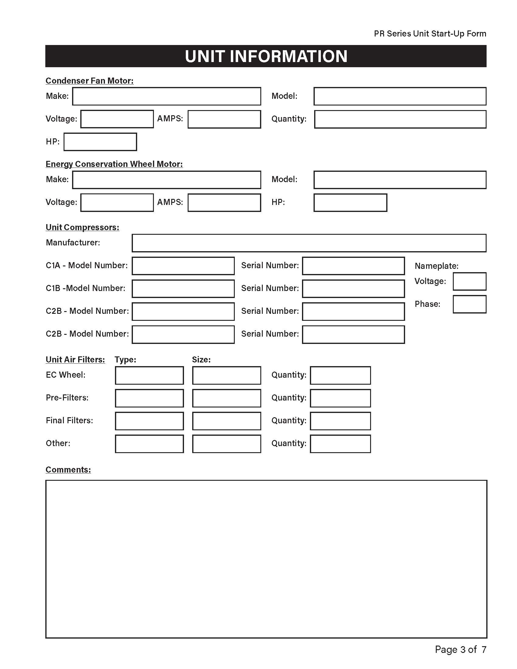
START-UP CHECK, TEST, AND STARTUP FORM

Slide 13
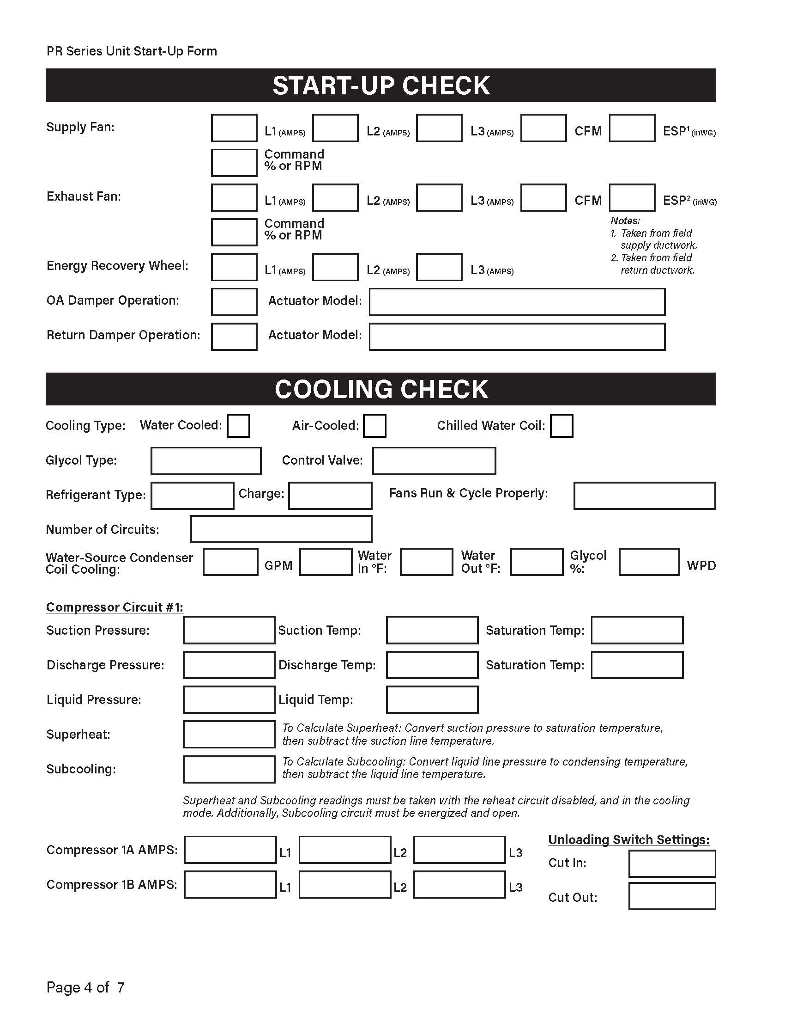
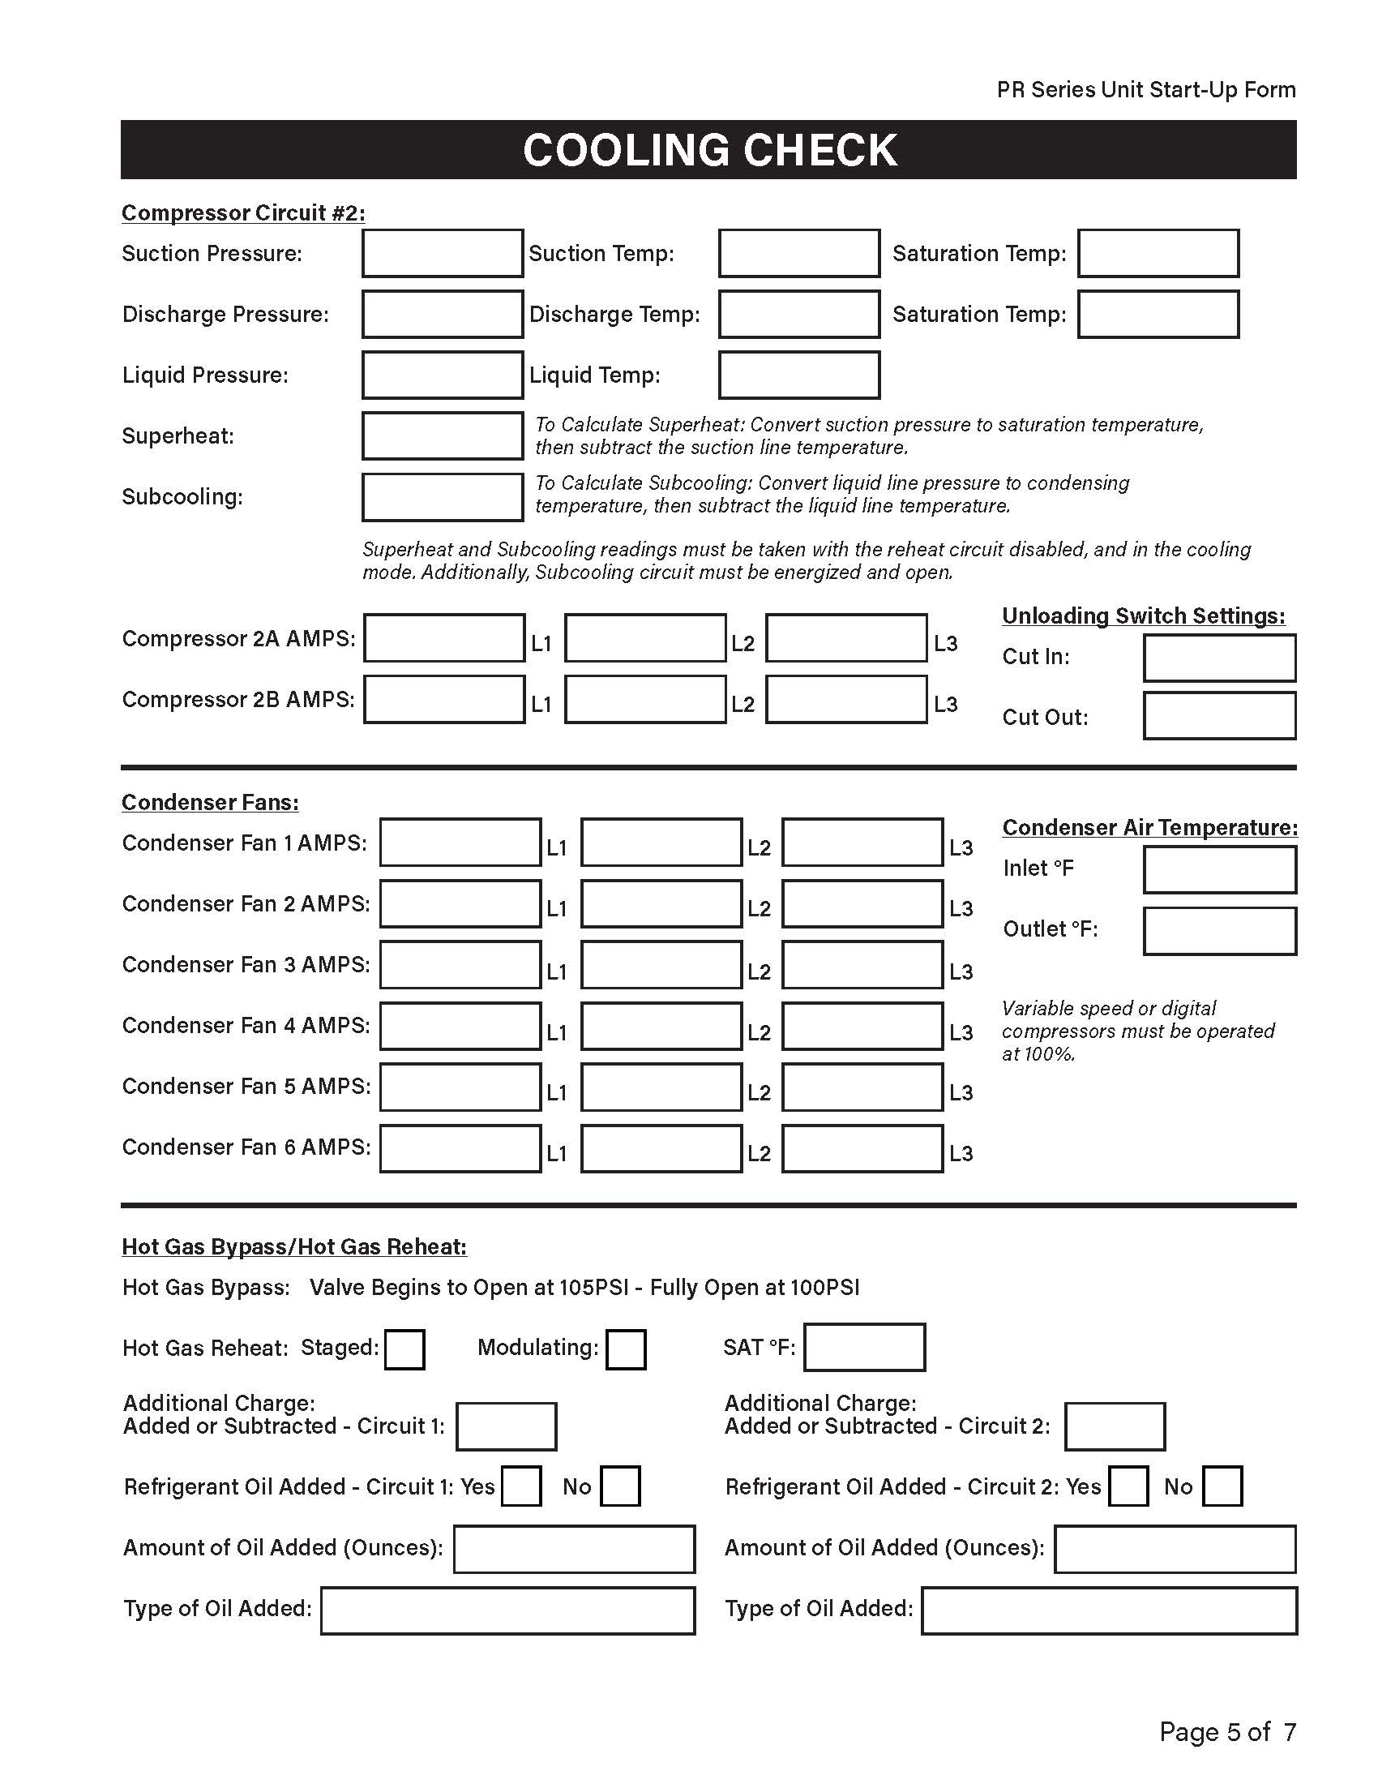
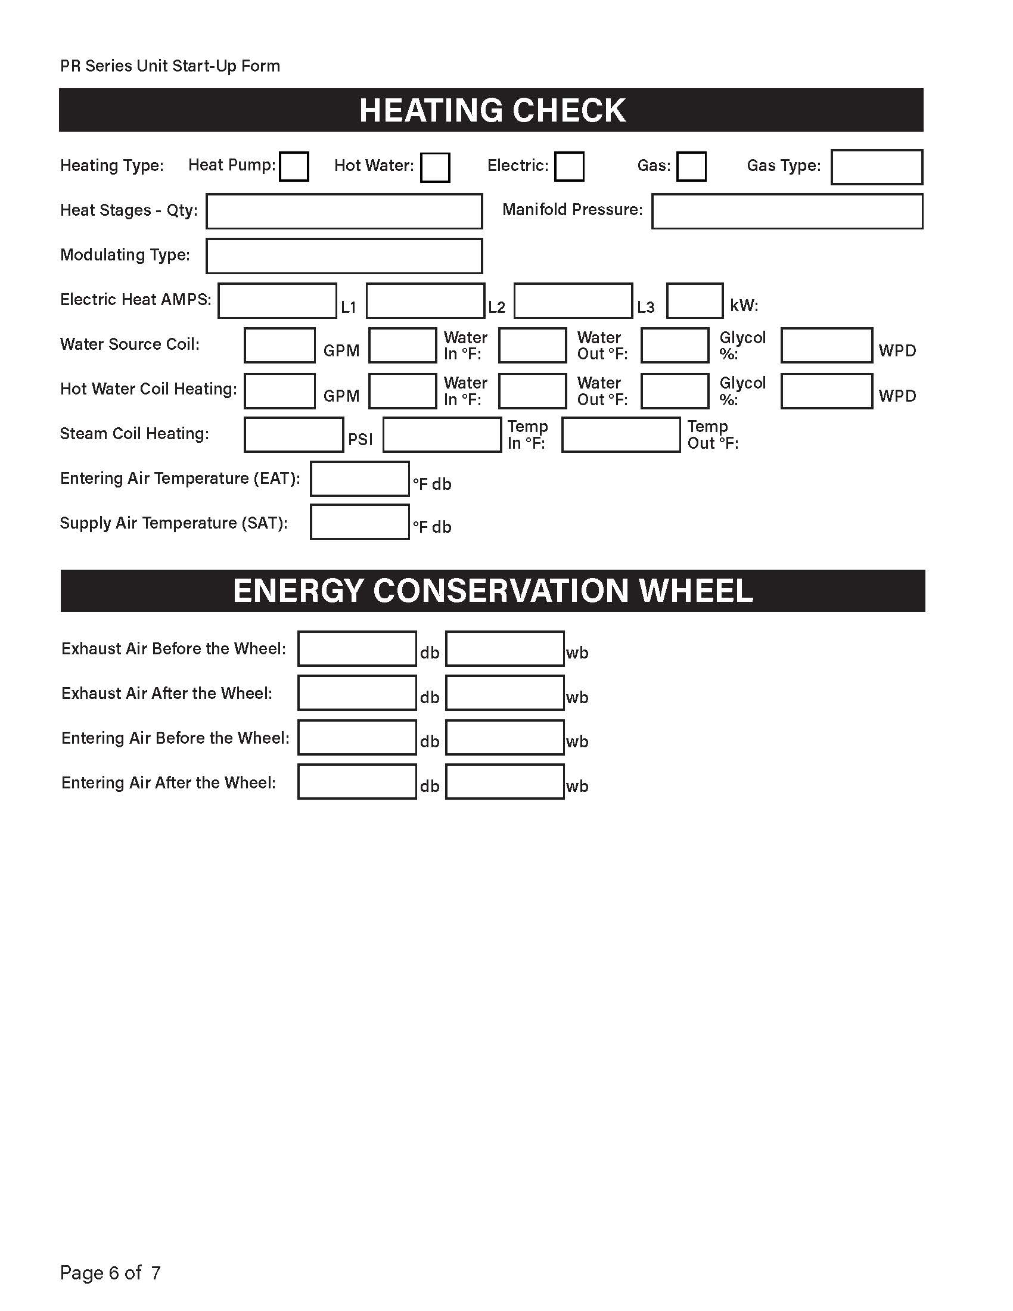
START-UP CHECK, TEST, AND STARTUP FORM

Slide 14
START-UP REQUIREMENTS
UNIT STARTUP PROCEDURES

Slide 15
START-UP REQUIREMENTS

Slide 16
START-UP REQUIREMENTS

Slide 17
START-UP REQUIREMENTS

Slide 18
START-UP REQUIREMENTS

Slide 19
START-UP REQUIREMENTS

Slide 20
START-UP REQUIREMENTS

Slide 21

PREVENTATIVE MAINTENANCE

Slide 22
PREVENTATIVE MAINTENANCE SERVICE ON EQUIPMENT
Filters:
  Must be checked at least once a month on commercial operations
Condensate Drain / Pan:
  Should always be checked whenever filters are changed to ensure the .condensate is draining properly
  The condensate pan should be cleaned and flushed every six (6) months

Slide 23
PREVENTATIVE MAINTENANCE SERVICE ON EQUIPMENT
Condensate P- Trap(s):
  Condensate “trap” drain line must adhere to factory insulation guidelines

Slide 24
PREVENTATIVE MAINTENANCE SERVICE ON EQUIPMENT
Contactor Points:
  Check twice (2) a year
Supply / Exhaust Fans:
  Be alert for any noise
ECW Wheel:
  Must be checked at least once (1) a month on commercial operations

Slide 25
PREVENTATIVE MAINTENANCE SERVICE ON EQUIPMENT
Refrigerant Pressure:
  Check at any time unit does not seem to be performing at top efficiency
Condenser Fan:
  Check for correct rotation
Condenser Fan Speed Control:
  Check for correct operation per head pressure

Slide 26
Factory Service Training Dates
November 14-16, 2023
February 20-22, 2024
March 19-21, 2024
April 23-25, 2024

Slide 27
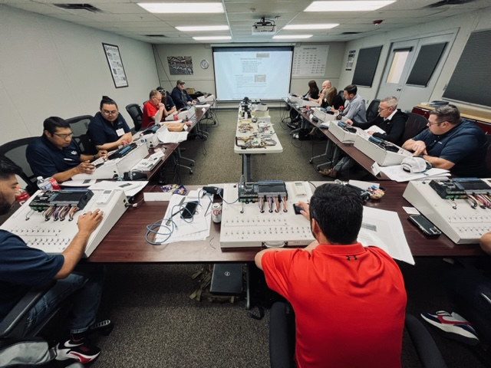
Factory Service Training

Slide 28
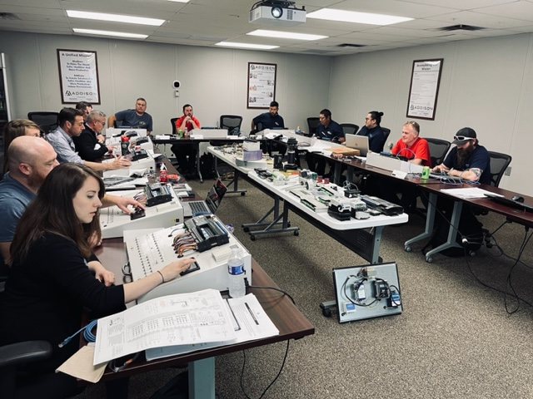
Factory Service Training

Slide 29
Thank you!

